Slide 1
CONCEPT
Purifying Cleansing Milk – Seborrhoe Sicca
Purifying Cleansing Gel – Seborrhoe Oleosa
Purifying Tonic
 Sebum Regulating Cream – Seborrhoe Sicca
Mattifying Gel – Seborrhoe Oleosa
 SOS Spot Concentrate
TREATMENT

Slide 2
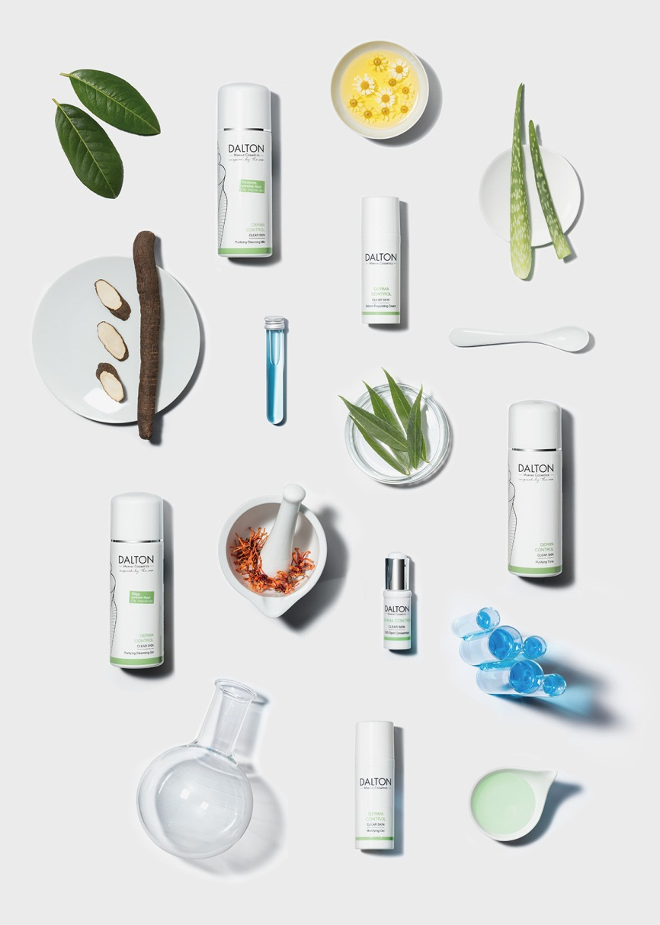
C O N C E P T
The DERMA CONTROL products are enriched with a combination of marine minerals and marine peptides with antibacterial effect. The peptides, which are obtained through sustainable bio technology, improve overall skin condition in a natural way. They prevent inflammatory breakouts, minimize pimple size and reduce redness caused by breakouts and blemishes, all without irritating the skin or stripping it of moisture. They also restore the skin‘s natural ability to heal itself and accelerate healing of existing pimples and pustules. An independent study produced impressive results:
55% reduced pimple size
52% fewer pustules
61% less redness
42% fewer pimples
61% improved skin condition
*Test design: 30 test persons with acne types 1 and 2, between 13 and 27 years of age. Application twice daily for 4 weeks. The study was done in vivo.
Modern skincare with anti-acne effect – For all ages and all skin types prone to breakouts

Slide 3
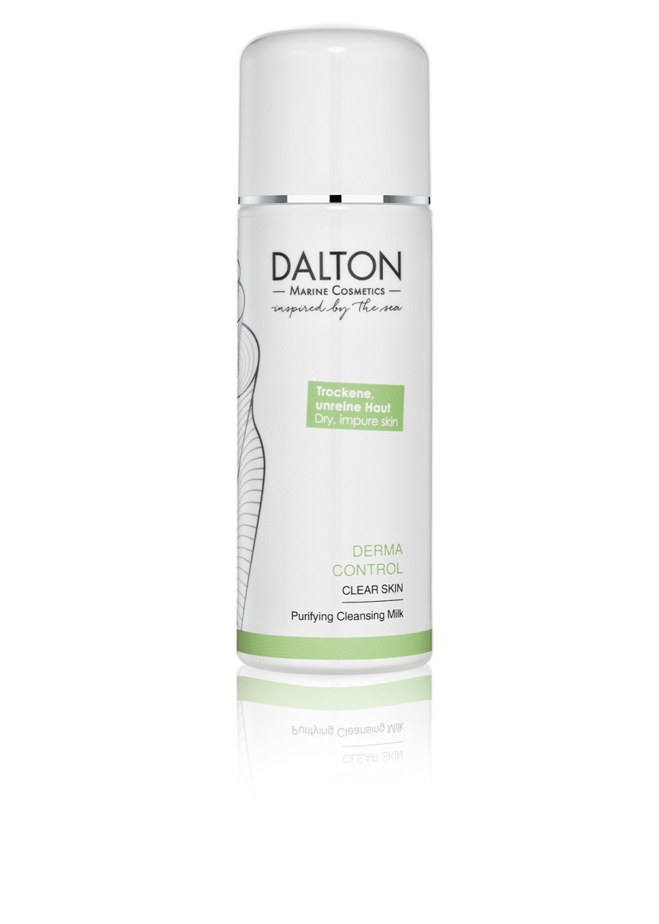
Purifying Cleansing Milk
If your skin tends to be dry and prone to breakouts, it‘s very important to use an appropriate cleanser. The antibacterial Purifying Cleansing Milk clears the skin without stripping it of moisture. It thoroughly removes all traces of make-up, dirt and environmental pollutants.
• Gently foaming milky texture
• Allows for gentle yet thorough cleansing
• Perfect cleanser for dry skin prone to blemishes and breakouts
TIP:
Follow with the DERMA CONTROL Purifying Tonic.
For dry skin with blemishes (Seborrhoea Sicca)
Ingr.

Slide 4
Purifying Cleansing Milk – Active Ingredients
Marine Minerals
Marine Peptides
Sunflower Oil
Soybean Oil
Vitamin E
 Marine MInerals
Marine Peptides
Sunflower Oil
Soybean Oill
Vitamin E
INCI
PURIFYING CLEANSING MILK

Slide 5
Purifying Cleansing Milk - INCI
Ingredients:
Aqua/Water, Cetearyl Alcohol, Helianthus Annuus Hybrid Oil/Helianthus Annuus (Sunflower) Seed Oil, Glycerin, Octyldodecanol, Dicaprylyl Ether, Alcohol, Cetearyl Glucoside, Maris Aqua/Sea Water, Micrococcus Lysate, Allantoin, Glycine Soja (Soybean) Oil, Helianthus Annuus (Sunflower) Seed Oil, Phenoxyethanol, Sorbitol, Tocopherol, Sodium Citrate, Tetrasodium Glutamate Diacetate, Distarch Phosphate, Carbomer, Sodium Polyacrylate, Caprylyl Glycol, Ethylhexylglycerin, Sodium Hydroxide, Disodium Cocoyl Glutamate, Retinyl Palmitate, Sodium Cocoyl Glutamate, Parfum/Fragrance

Slide 6
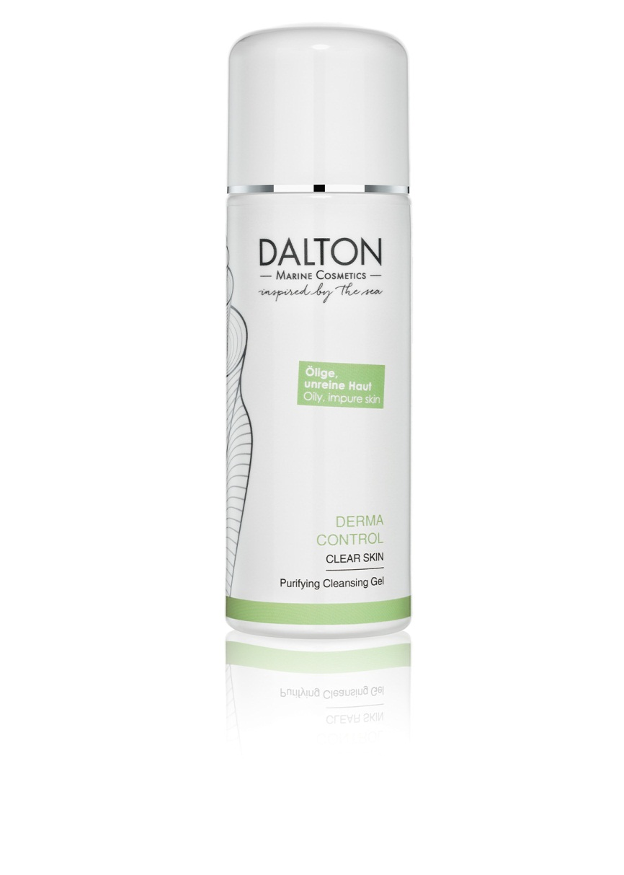
Purifying Cleansing Gel
Allows for gentle yet thorough cleansing. Removes all traces of make-up, environmental pollution and excess sebum.
Carefully chosen ingredients help to maintain a clean and clear complexion.
• Light, non-greasy gel texture
• For refreshing and pore-deep cleansing
• Leaves the skin feeling calm and comfortable, no oily residue
• Perfect cleanser for oily skin prone to blemishes and breakouts
For oily skin with blemishes (Seborrhoea Oleosa)
Ingr.

Slide 7
Purifying Cleansing Gel – Active Ingredients
Marine Minerals
Marine Peptides
Allantoin
Citric Acid
 Marine Minerals
Marine Peptides
Allantoin
Citric Acid
INCI
PURIFYING CLEANSING GEL

Slide 8
Purifying Cleansing Gel - INCI
Ingredients:
Aqua/Water, Coco-Glucoside, Sodium Coco-Sulfate, Glycerin, Lauryl Glucoside, Betaine, Sodium Chloride, Maris Aqua/Sea Water, Micrococcus Lysate, Allantoin, Potassium Sorbate, Phenoxyethanol, Sodium Benzoate, Glyceryl Laurate, Glyceryl Oleate, Cocamidopropyl Betaine, Citric Acid, Disodium Cocoyl Glutamate, Sodium Cocoyl Glutamate, Parfum/Fragrance

Slide 9
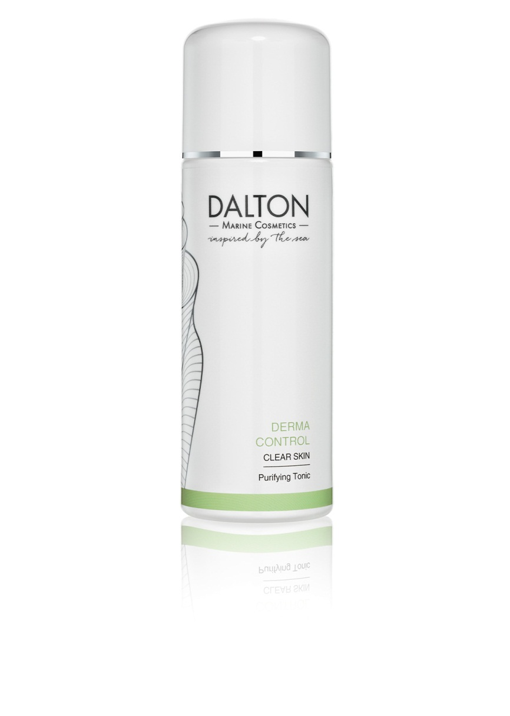
Purifying Tonic
Rinsing your face with water disrupts the skin‘s pH levels, which can lead to a range of skin problems. The skin‘s pH plays an important role in maintaining flawless skin without pimples and blemishes. The tonic balances the pH and reinforces the skin‘s acid mantle. It also clears the skin and prevents the formation of new blemishes, without stripping the skin of moisture.
• Gentle, alcohol-free toner
• Balancing and anti-inflammatory
• Regulates sebum production, astringent effect
• Restores the skin‘s natural pH after cleansing
• For a fresh and clear complexion
Invaluable aid for skin prone to blemishes
Ingr.

Slide 10
Purifying Tonic – Active Ingredients
Marine Minerals
Marine Peptides
Aloe Vera
Panthenol (Provitamin B5)
Citric Acid
Lactic Acid
 Marine Minerals
Marine Peptides
Aloe Vera
Panthenol
Citric Acid
Lactic Acid
INCI
PURIFYING TONIC

Slide 11
Purifying Tonic - INCI
Ingredients:
Aqua/Water, Glycerin, Butylene Glycol, Propylene Glycol, Pentylene Glycol, Aloe Barbadensis Leaf Juice, Polyglyceryl-10 Laurate, Maris Aqua/Sea Water, Micrococcus Lysate, Panthenol, Lactic Acid, Citric Acid, Vaccinium Macrocarpon (Cranberry) Fruit Extract, Sorbic Acid, Ethylhexylglycerin, Phenoxyethanol, Potassium Sorbate, Sodium Benzoate, Sodium Lactate, PVP, Parfum/Fragrance

Slide 12
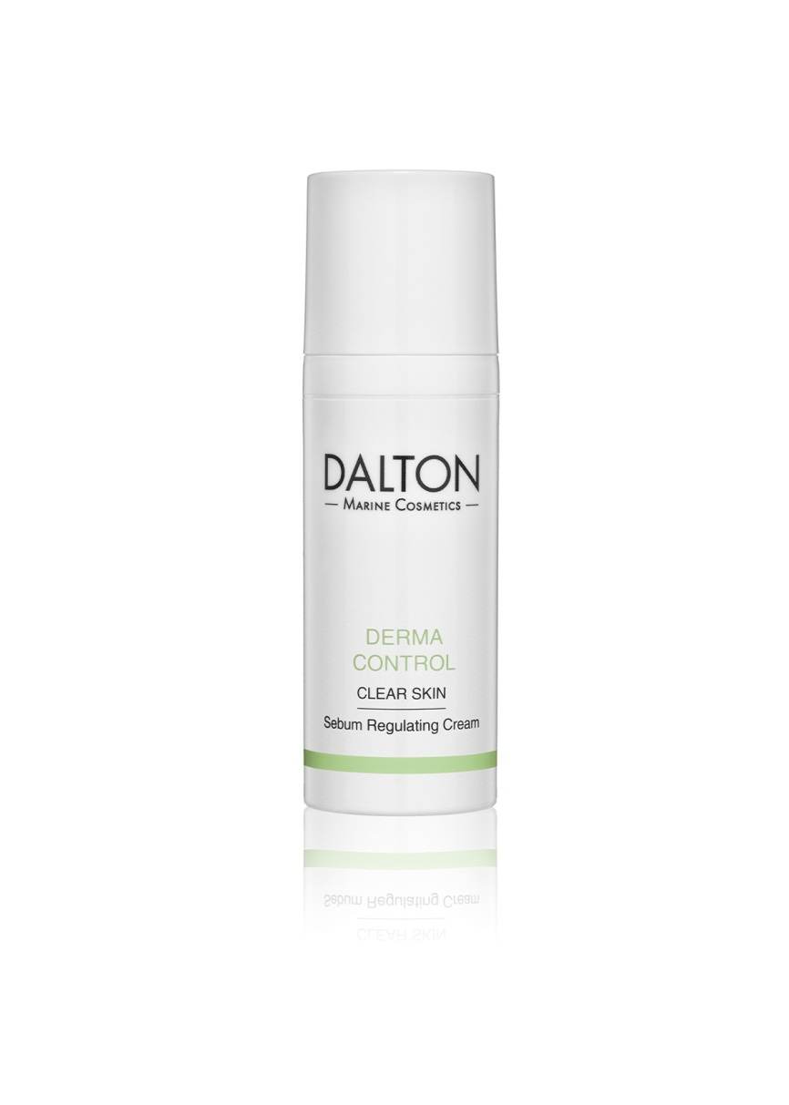
Sebum Regulating Cream
Moisturizing Cream with a delicate, non-greasy texture that balances dry skin with blemishes. The combination of active ingredients has a soothing, balancing and moisturizing effect.
Calms and reduces inflammatory blemishes
Reduces irritation and redness
Quick and easy to use
For a healthy, even-toned complexion
For dry skin with blemishes
(Seborrhoea Sicca)
Ingr.

Slide 13
Sebum Regulating Cream – Active Ingredients
Marine Minerals
Marine Peptides
Hamamelis (Witch Hazel)
Salicylic Acid
Bisabolol
Vitamin E
Soybean Oil
 Marine Minerals
Marine Peptides
Hamamelis
Salicylic Acid
Bisabolol
Vitamin E
Soybean Oil
INCI
SEBUM REGULATING CREAM

Slide 14
Sebum Regulating Cream - INCI
Ingredients:
Aqua/Water, Cetearyl Alcohol, Caprylic/Capric Triglyceride, Glyceryl Stearate Citrate, Dicaprylyl Ether, Glyceryl Stearate, Propylene Glycol, Sodium Lactate, Panthenol, Distarch Phosphate, Maris Aqua/Sea Water, Micrococcus Lysate, Salix Alba (Willow) Bark Extract, Hamamelis Virginiana (Witch Hazel) Water, Citric Acid, Glycine Soja (Soybean) Oil, Tocopherol, Bisabolol, Sodium Hydroxide, Phenoxyethanol, Helianthus Annuus (Sunflower) Seed Oil, Retinyl Palmitate, Tetrasodium Glutamate Diacetate, Glyceryl Caprylate, Glycerin, Xanthan Gum, Sodium Stearoyl Glutamate, Polyacrylate Crosspolymer-6, Ethylhexylglycerin, Alcohol, Potassium Sorbate, Sodium Benzoate, Parfum/Fragrance

Slide 15
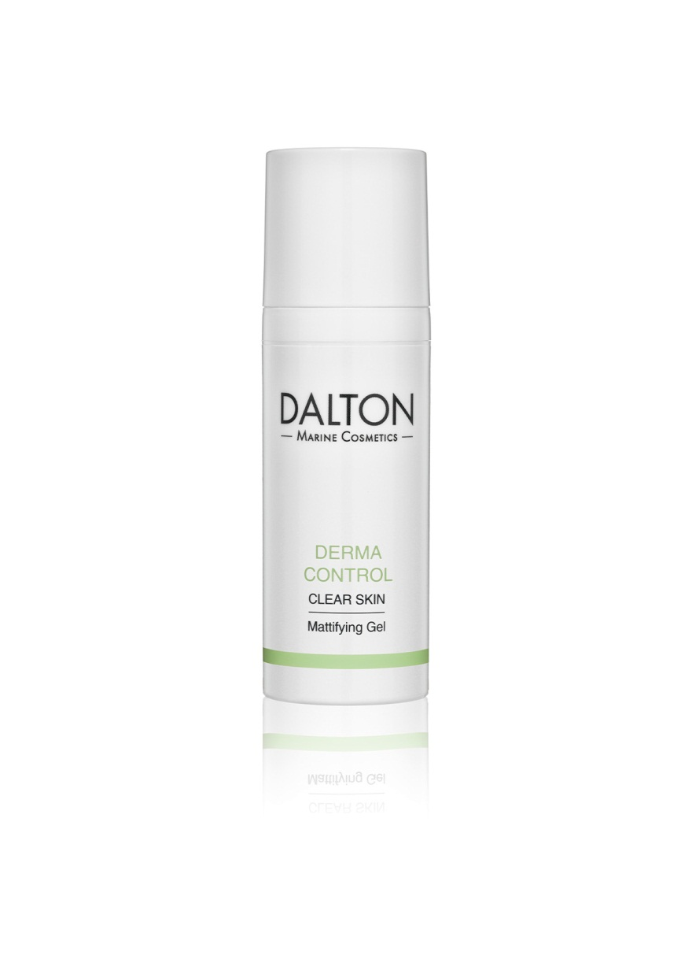
Mattifying Gel
The light, fast-absorbing Mattifying Gel is a perfect product for very oily skin with blemishes (so-called Seborrhoea Oleosa). Its non-greasy texture reduces oily shine without stripping the skin of moisture and minimizes enlarged pores. Vitamin A protects the skin against the harmful effects of free radicals.
Antibacterial and anti-inflammatory effect
Non-greasy and quickly absorbed
Regulates excessive sebum production and gives a mattified look
For a balanced, matte complexion
Perfect matte complexion for Seborrhoea Oleosa
Ingr.

Slide 16
Mattifying Gel – Active Ingredients
Marine Minerals
Marine Peptides
Salicylic Acid
Hamamelis (Witch Hazel)
Bisabolol
Panthenol (Provitamin B5)
Vitamin A
Kaolin
 Marine Minerals
Marine Peptides
Salicylic Acid
Hamamelis
Bisabolol
Panthenol
Vitamin A
Kaolin
INCI
MATTIFYING GEL

Slide 17
Mattifying Gel - INCI
Ingredients:
Aqua/Water, Glycerin, Talc, Butylene Glycol, Panthenol, Maris Aqua/Sea Water, Micrococcus Lysate, Salix Alba (Willow) Bark Extract, Bisabolol, Sodium Hydroxide, Hamamelis Virginiana (Witch Hazel) Water, Carbomer, Phenoxyethanol, Citric Acid, Kaolin, Propylene Glycol, Helianthus Annuus (Sunflower) Seed Oil, Caprylyl Glycol, Ethylhexylglycerin, Retinyl Palmitate, Alcohol, Potassium Sorbate, Sodium Benzoate, Parfum/Fragrance

Slide 18
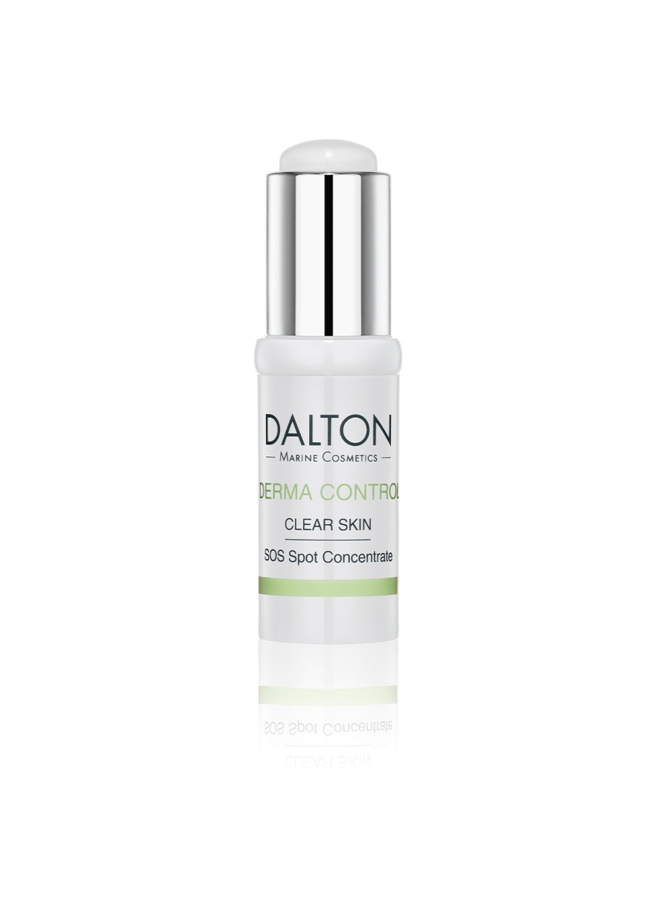
SOS Spot Concentrate
Liquid formula of concentrated active ingredients with an antibacterial effect that works miracles against pimples and blemishes.
Application: Apply topically to developing or existing pimples.
• Antibacterial and anti-inflammatory effect
• Fights blemishes and inflammation without drying the skin
• Soothes redness and inflamed skin areas
• Immediate solution for a beautiful, clear complexion
TIP: Excellent SOS product with compact packaging that makes it perfect to take along anywhere you go.
Immediate Spot Treatment
Ingr.

Slide 19
SOS Spot Concentrate – Active Ingredients
Marine Minerals
Marine Peptides
Panthenol (Provitamin B5)
Soy Proteins
Camphor
Citric Acid
Lactic Acid
 Marine MInerals
Marine Peptides
Panthenol
Soy Proteins
Camphor
Citric Acid
Lactic Acid
INCI
SOS SPOT CONCENTRATE

Slide 20
SOS Spot Concentrate - INCI
Ingredients:
Alcohol Denat. (SD Alcohol 39-C)/Alcohol Denat., Aqua/Water, Glycerin, Polyglyceryl-10 Laurate, Maris Aqua /Sea Water, Micrococcus Lysate, Panthenol, Lactic Acid, Hydrolyzed Soy Protein, Camphor, Citric Acid, Phenoxyethanol, PVP, Parfum/Fragrance

Slide 21
DERMA CONTROL – CLEAR SKIN for a clear, unblemished complexion
STEP-BY-STEP GUIDE | PRODUCT | APPLICATION, SPECIAL FEATURES & TIPS
Eye Make-up Removal (if necessary) | CLASSIC CLEAN – ALL SKIN TYPES Eye Make-up Remover | Tip: Ask your client to bring their favorite music with them on their smartphone. The music can be played during the treatment for individual relaxation.
Cleansing | DERMA CONTROL Purifying Cleansing Milk or Purifying Cleansing Gel | Use a cleanser that suits the skin type: Dry skin with blemishes→ Cleansing Milk Oily skin with blemishes→Cleansing Gel Apply only light pressure during the cleansing massage. Use draining techniques if possible. Remove the cleanser thoroughly afterwards.
Tonic | DERMA CONTROL Purifying Tonic
Exfoliation | COMFORT CLEAN – SOFT SKIN EFFECT Enzyme Peeling or PROFESSIONAL CARE Intense Purifying – AHA 60% pH 3,6 | If the skin is very thin and dry, use the Enzyme Peeling. Do a quick exfoliating massage only if there are no open sores or pimples If the skin is oily and more robust, use the AHA Peeling.
Extraction | DERMA CONTROL Purifying Tonic and SOS Spot Concentrate | After rinsing the Peeling, tone the skin once again and - if the skin is very dry – you can keep applying the Tonic during the extraction. Afterwards apply the Concentrate topically to the affected areas or spots.
Mask | PROFESSIONAL CARE Derma Control Clear Skin Peel-off Mask | The occlusive effect carries the active ingredients of the Spot Concentrate deeper into the skin. The pleasantly cooling effect of the mask benefits this type of skin in particular.
Hand Massage | NATURAL CORRECTEUR The Oil | Severe breakouts are a contraindication for facial massage (smear infection!). A hand massage offers total relaxation and wellness while the mask is doing its work.
Final Care | DERMA CONTROL Sebum Regulating Cream or Mattifying Gel | Finish with a suitable moisturizer. Apply sparingly: Dry skin with blemishes → Regulating Cream Oily skin with blemishes → Mattifying Gel
Total Time Required (including 15 minutes of extraction) Recommended Price (based on German retail prices) | ~ 60 minutes ~ 54,90 – 60,00€

Slide 22
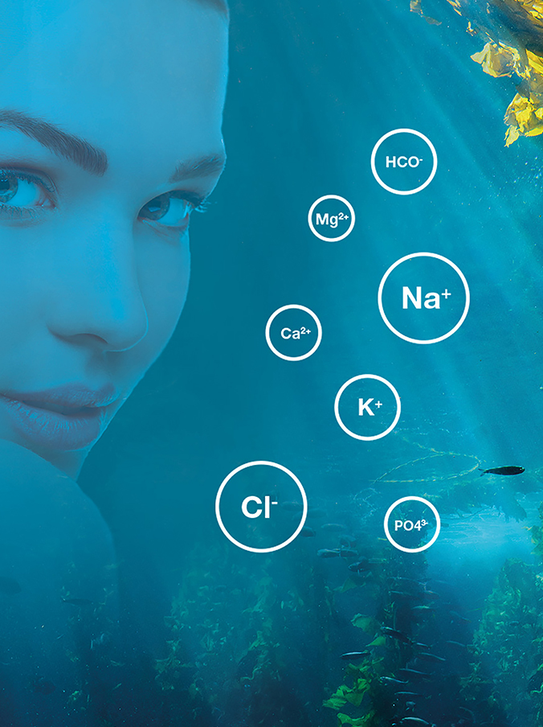
Marine Minerals
The composition of the Celumer Marine Minerals is similar to blood plasma, which allows for quicker absorption of active ingredients into deeper layers of the skin. As the combination is known to the body, they serve as a „means of transport“ for further active ingredients into the skin.
Cell supply
Better absorption of active ingredients
Very well tolerated by the skin

Slide 23
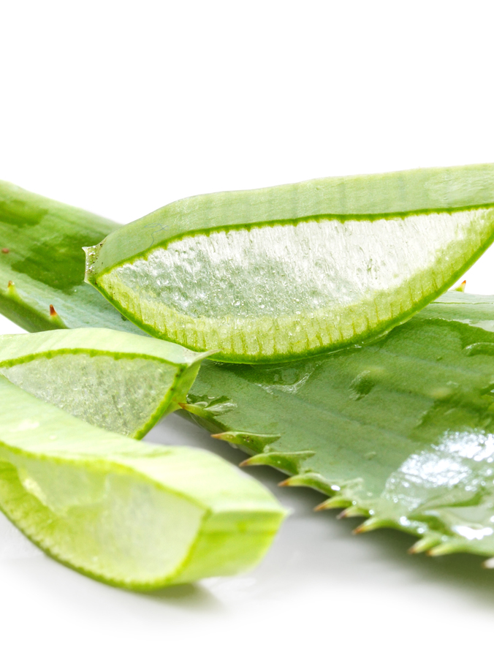
Aloe Vera
An extract obtained from the leaves of the Aloe barbadensis, Liliaceae which contains vitamins, enzymes, mineral nutrients and amino acids. The cosmetic effect of this natural gel is as follows:
Leaves the skin feeling smooth and supple
Delivers hydration
Offers wound-healing and anti-inflammatory properties
Has a natural cooling effect
Promotes the skin‘s self-healing powers

Slide 24
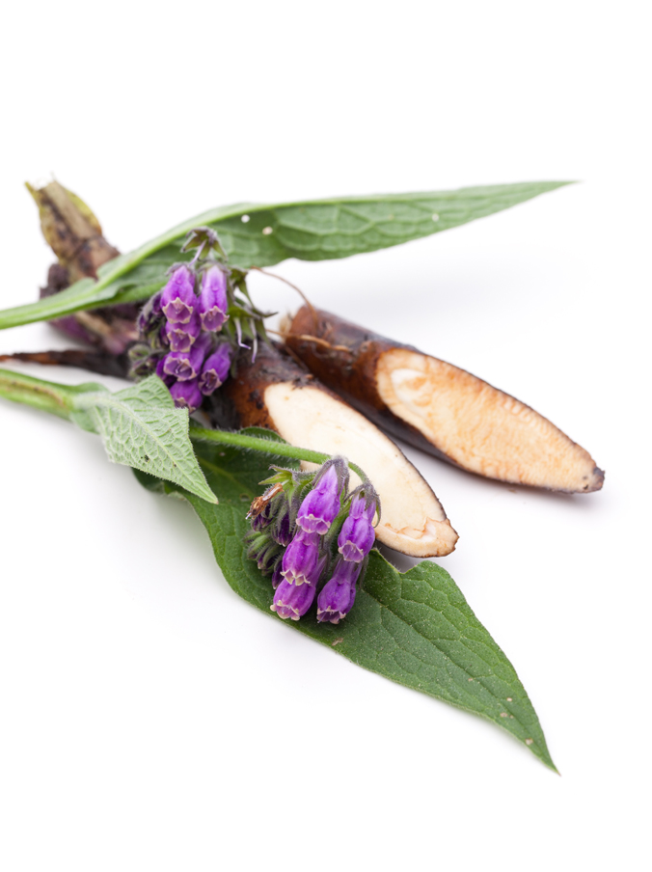
Allantoin
Allantoin is a natural-source substance found in plants such as comfrey (Symphytum officinale), maple, wheat germ and black salsify. It was already used by Hildegard von Bingen to help heal wounds and bone fractures.
Promotes healing
Calms and soothes
Stimulates cell division
Softens and smoothes skin (= keratoplastic)

Slide 25
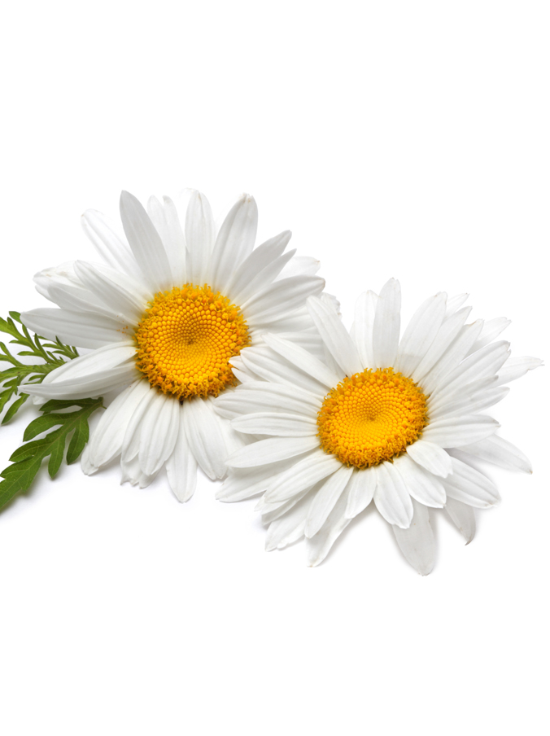
Bisabolol
Bisabolol is the primary constituent of chamomile oil. The colorless substance serves as an anti-inflammatory and has a slightly sweetish flavour. For thousands of years the chamomile has been known as a traditional home remedy. It has antibacterial properties and also provides multiple skin care benefits. Bisabolol is just as effective as the chamomile but has a significantly lower allergy rate.
Anti-inflammatory
Calming and soothing

Slide 26
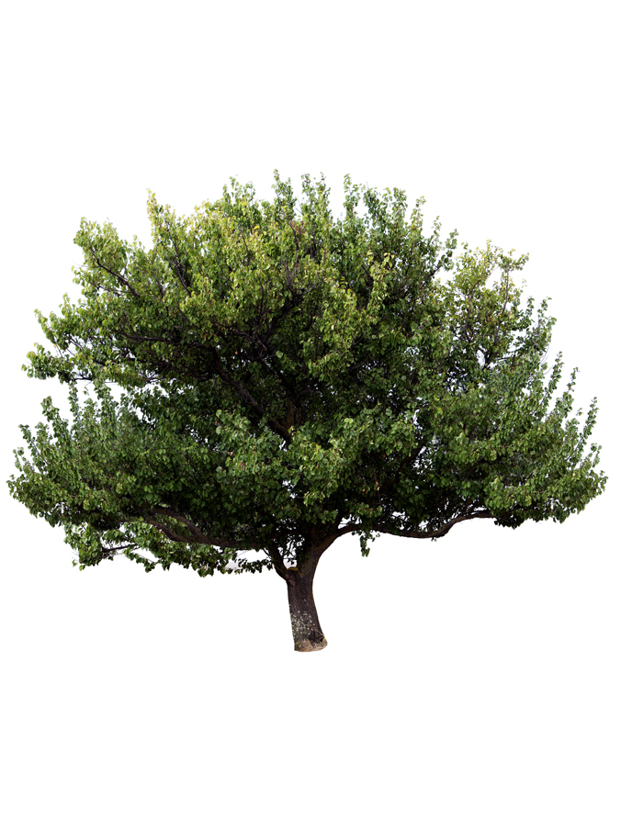
Camphor
Camphor is a lipophilic ingredient found in the essential oils of the camphor tree. The camphor tree is native to the Himalayas, where it thrives even at an altitude of more than 1000 meters. Camphor was used as a healing plant by Hildegard von Bingen, who used it to treat febrile diseases, rheumatism and colds. To this day, camphor is widely used for medicinal purposes, mainly in Asia.
Antiseptic
Anti-inflammatory
Bactericidal and antimicrobial

Slide 27
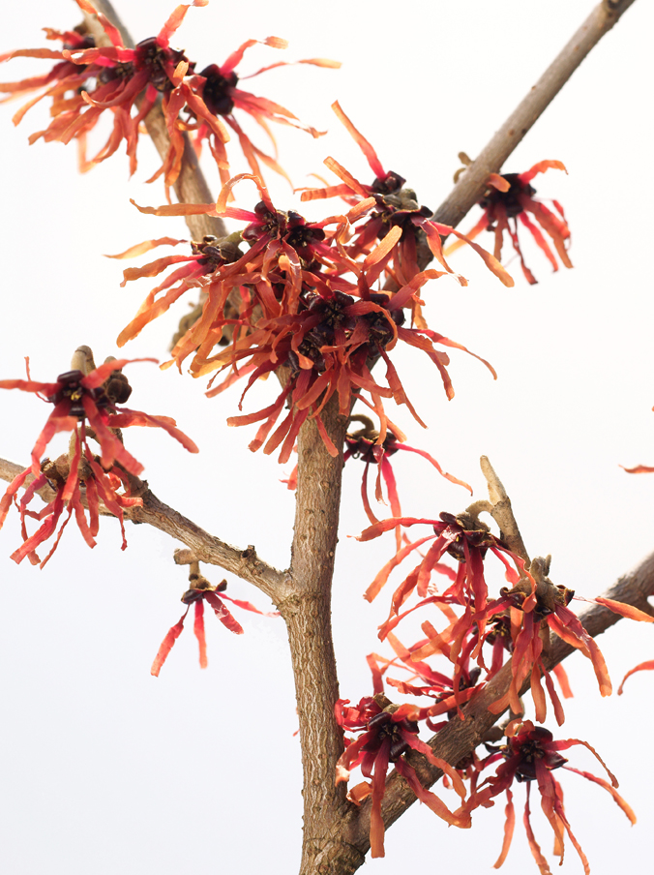
Hamamelis
An extract derived from the bark, leaves and twigs of the common witch hazel (Hamamelis virginiana). In addition to its traditional medicinal employment, the plant is cosmetically used because of its
skin conditioning
wound-healing
astringent
soothing
properties.

Slide 28
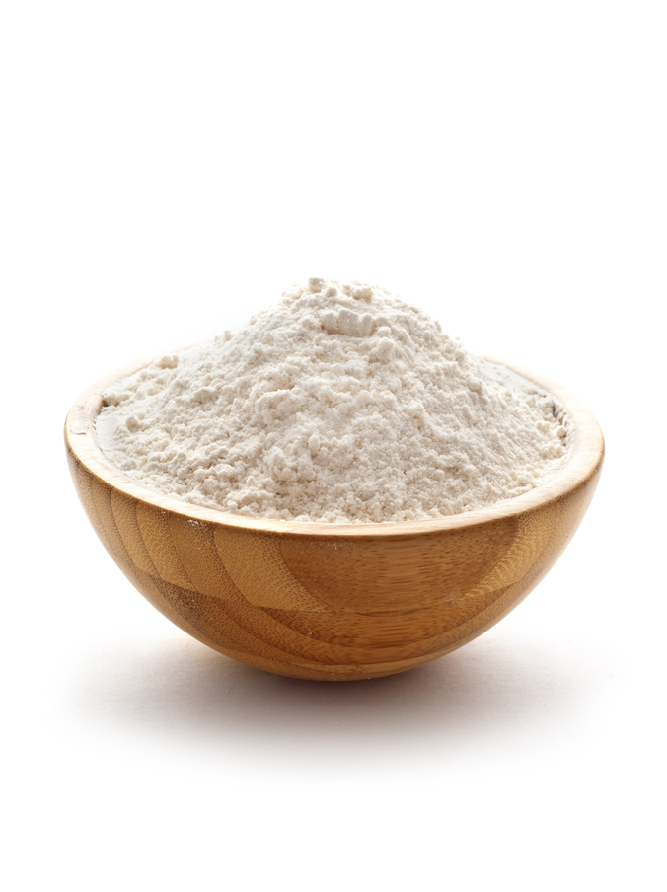
Kaolin
Kaolin, also known as porcelain clay, china clay, white clay or Bolus alba, is a fine, iron-free, white clay. Its main constituent is kaolinite (which is formed by weathering of feldspar).
Has detoxifying and cleansing properties („blotting paper effect“)
Refines pores
Calms and soothes
Is well tolerated by the skin

Slide 29
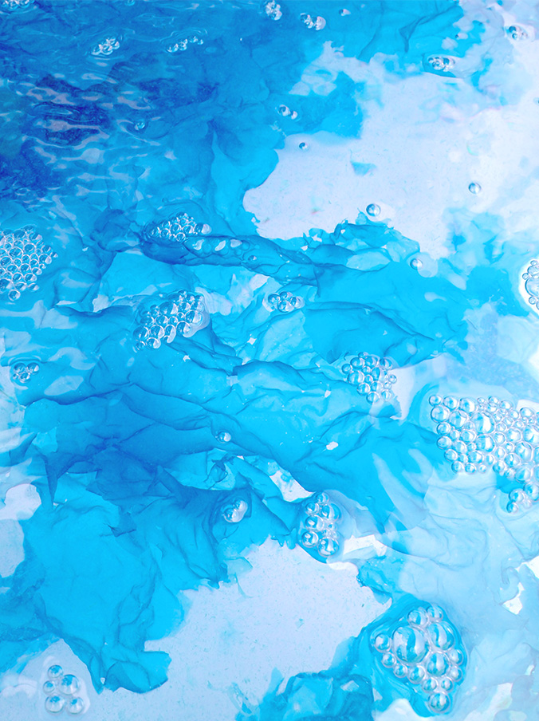
Marine Peptides
The marine peptides are obtained through Blue Technology, which means that marine raw materials and ingredients are won and prepared in an environmentally friendly way. That is how they keep their extraordinary effect, without significant negative impact on the environment.
Marine peptides are protein fragments derived from marine microorganisms that occur in particular in the sea around the Cabo de Gata at the Playa de los Muertos (UNESCO Biosphere Reserve in Spain). The natural Blue Technology peptides have a particularly favorable effect on blemished skin:
Strong antibacterial and anti-inflammatory properties
Reduces blemishes and clogged pores
Very well tolerated even by very sensitive skin
Studies have proven their effectiveness and tolerability

Slide 30
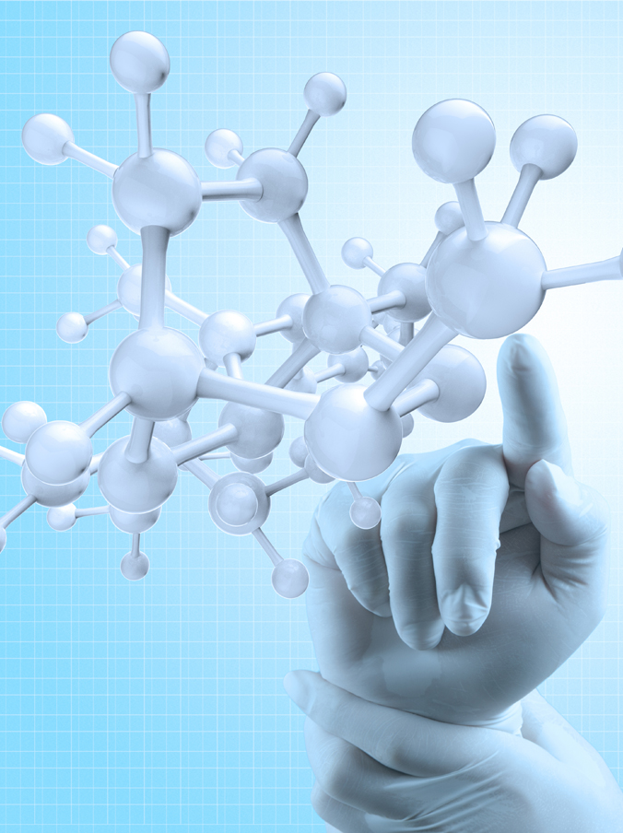
Lactic Acid
Both Europe and Asia have a fine history of using lactic acid for pickling and preserving foods (sour milk, sauerkraut, etc.) When incorporated into skin care products, it offers these benefits:
Hydrates the skin
Has a gentle keratolytic and refining effect
Keeps skin soft and smooth
Is well tolerated by the skin

Slide 31
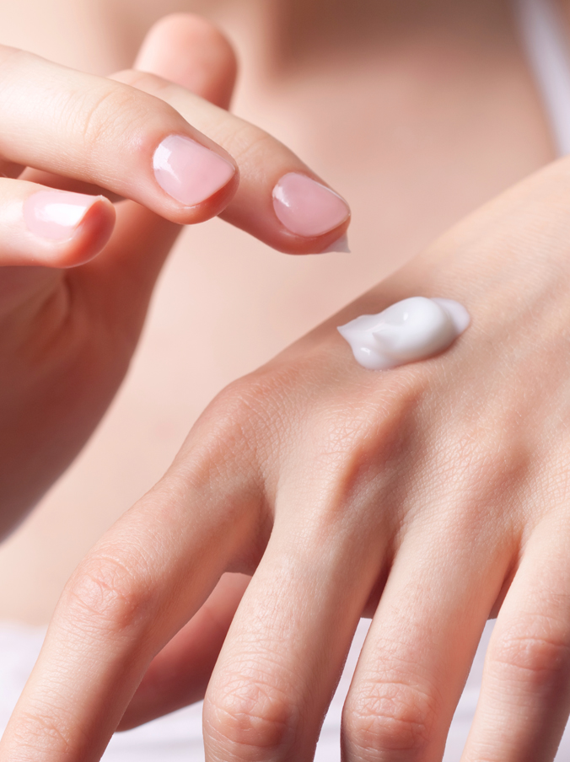
Panthenol (Provitamin B5)
Panthenol is a provitamin (vitamin precursor). It is converted to panthothenic acid (vitamin B5) in the body. This soothing active ingredient is very often used in ointments and salves. Panthenol is popular in cosmetics due to the following beneficial properties:
Moisturizes the skin
Promotes skin cell renewal (epithelialization)
Enhances skin elasticity
Offers anti-inflammatory properties
Soothes irritated and damaged skin
Is very well tolerated by the skin

Slide 32
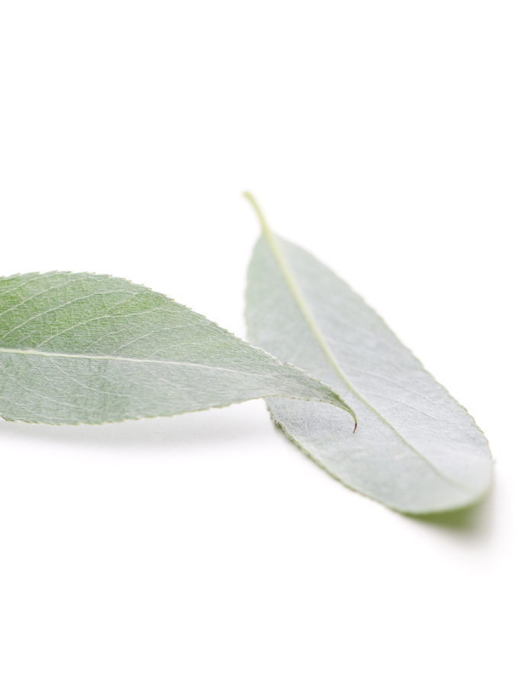
Salicylic Acid
Salicylic acid is obtained from the white willow plant (Salix alba). It has been used in medicine for decades but is also very well suited for use in cosmetics.
Astringent
Strengthening
Nourishing
Soothing
Promotes healing
Salicylic acid is especially helpful in treating acne, due to its keratolytic, anti-inflammatory and antibacterial properties.

Slide 33
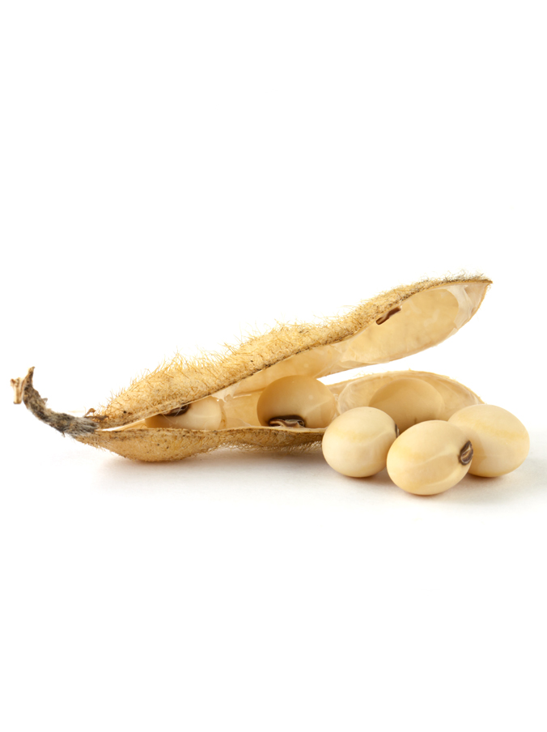
Soy Proteins
Soybeans were first cultivated in northern China in 7000 B.C. Today, they are grown worldwide.
In skin care products, soy proteins provide these benefits:
Keep skin soft and supple
Add smoothness to the skin
Hydrating
Protect skin against hormone-induced aging

Slide 34
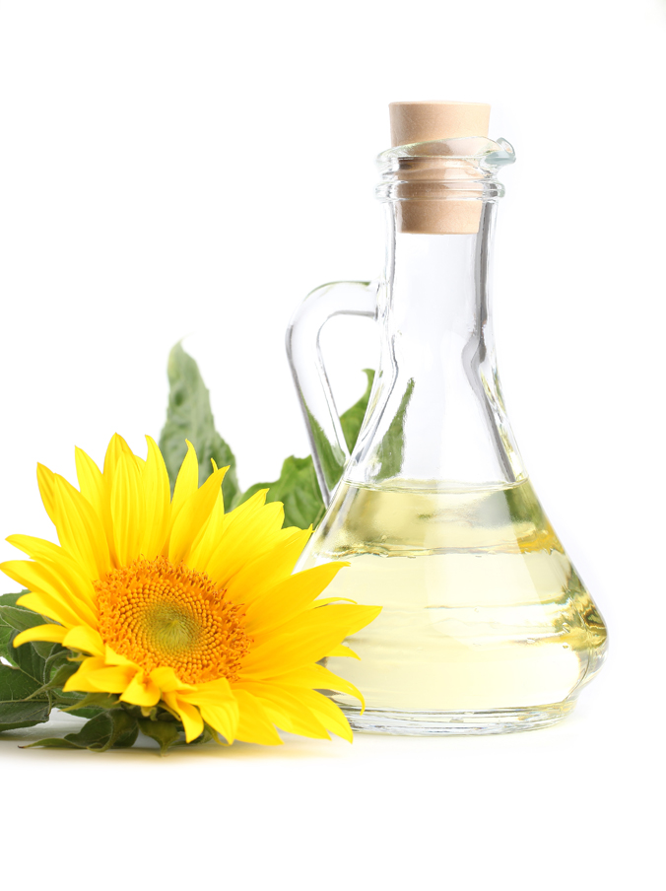
Sunflower Oil
is produced from the oil type seeds of the sunflower (Heliantus annuus) and is of a pale yellow colour.
When used in skin care products, it has these benefits:
Leaves skin smooth and supple
Keeps skin in good condition
Is high in unsaturated fatty acids
Is a rich source of vitamin E (antioxidant activity)

Slide 35
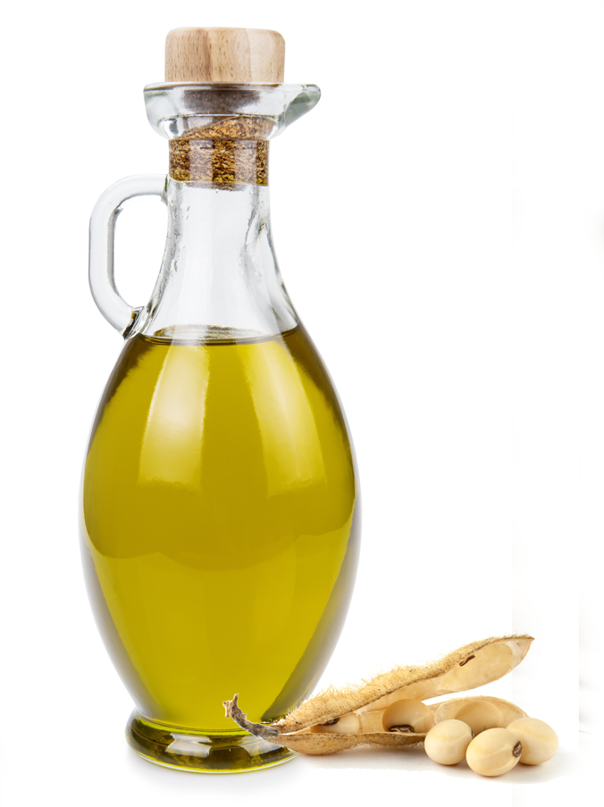
Soybean Oil
Vegetable oil that is won from the soybean. The oil can be won in two different ways – pressing and extraction. It is especially rich in essential fatty acids.
Soybean oil is a valuable active ingredient in cosmetics, with numerous benefits:
Supports cell renewal
Helps prevent symptoms of aging
Moisture-binding and lipid regulating
Leaves the skin looking smooth and supple

Slide 36
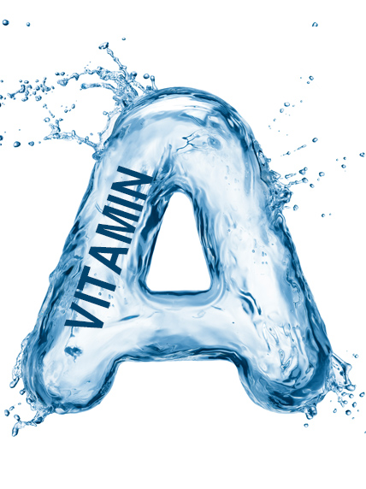
Vitamin A
Vitamin A is not a single substance, but a group of substances that includes a whole range of organic compounds. Hardly any other nutrient is more essential for our bodily functions than vitamin A.
Vitamin A is called the eye vitamin. In 1500 BC, the Chinese used liver in honey, which is rich in vitamin A, as a cure for night blindness. In addition, vitamin A also helps to keep the skin and mucous membranes healthy.
It offers the following benefits in skincare:
• Promotes collagen production
• Protects against light-induced sun damage
• Regenerates cells
• Protects the skin against free radicals (antioxidant)

Slide 37
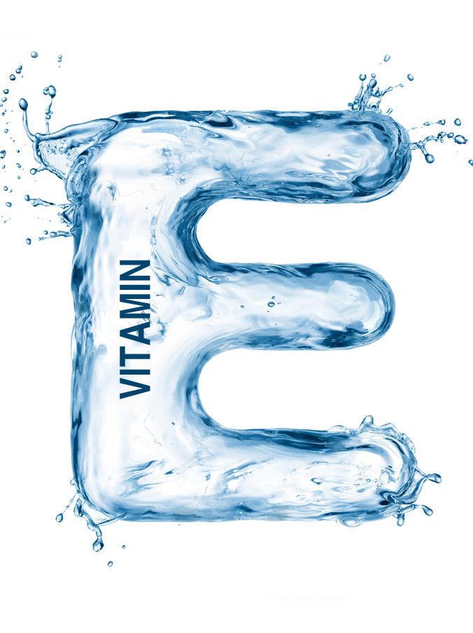
Vitamin E
Vitamin E is not just a single substance, but a whole family of fat-soluble nutrients. However, the term vitamin E is generally used for α-tocopherol, the best-researched form of vitamin E. The body obtains vitamin E through dietary intake. The richest sources of vitamin E are vegetable oils. Vitamin E was first discovered as a ‘fertility vitamin’ by US researchers Herbert M. Evans and Katherine S. Bishop in 1922. In the following years, the vitamin was isolated from wheat germ oil, corn and oats. Since vitamins A, B, C and D were already discovered, tocopherol was given the name vitamin E.
Anti-aging vitamin
Strong antioxidant effect -> protects the cells
Improves the epithelialization of the skin and its ability to retain moisture

Slide 38
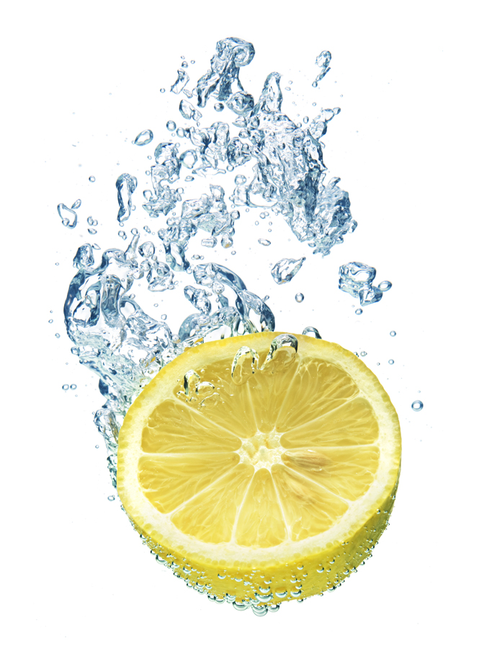
Citric Acid
Citric Acid is widely distributed throughout nature.
Used in skin care products, it offers the following properties:
Astringent
Keratolytic
Brightening
Helps accelerate cell renewal
Reduces wrinkle depth

Slide 39
COPYRIGHT & DISCLAIMER
COPYRIGHT. All pictures and images, the presentation design and the content provided in this training material are subject to copyright law and intellectual property protection and may only be used for the training of authorized DALTON aestheticians. Any distribution (analog/digital) or the use of any text or image requires the prior written consent of DALTON COSMETICS GERMANY GmbH.
DISCLAIMER. This training material forms part of the theoretical and practical training concept of DALTON COSMETICS GERMANY GmbH and requires further verbal explanation and practical experience to be complete. Therefore, DALTON COSMETICS GERMANY GmbH cannot be held liable for the completeness of the information provided herein.
DALTON COSMETICS GERMANY GmbH
Schulungsabteilung / Training Centre
Hauptstr.6, 94571 Schaufling, Deutschland / Germany

