Slide 1
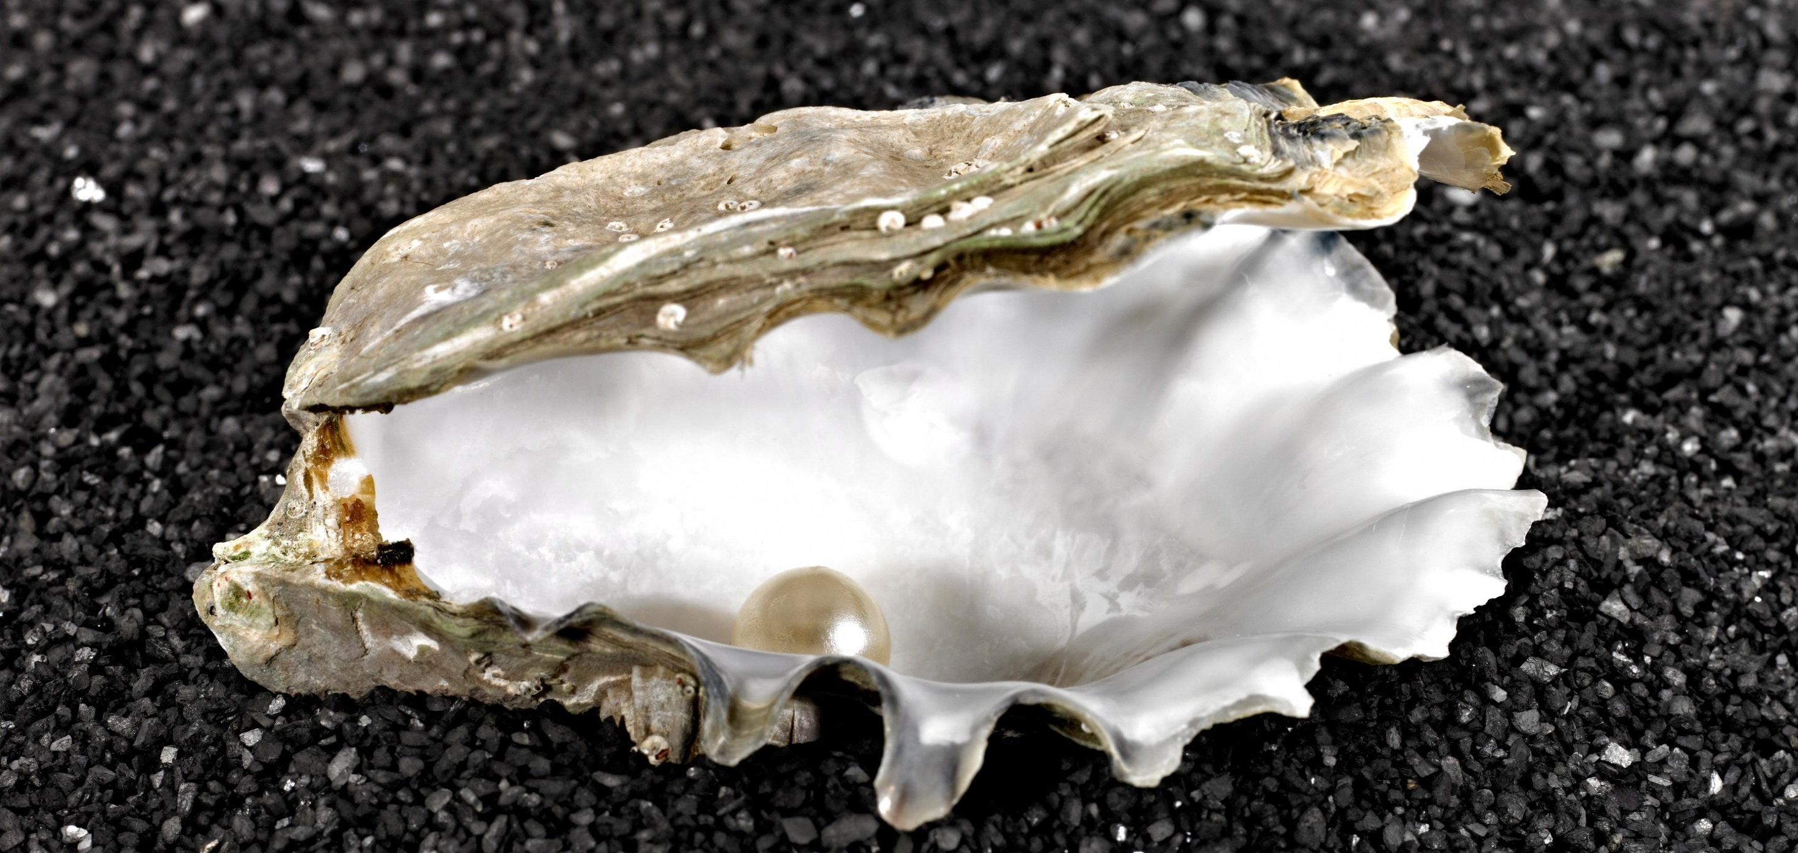
CONCEPT
Cream
Mask
Pipette Concentrate
IN-SALON TREATMENT

Slide 2
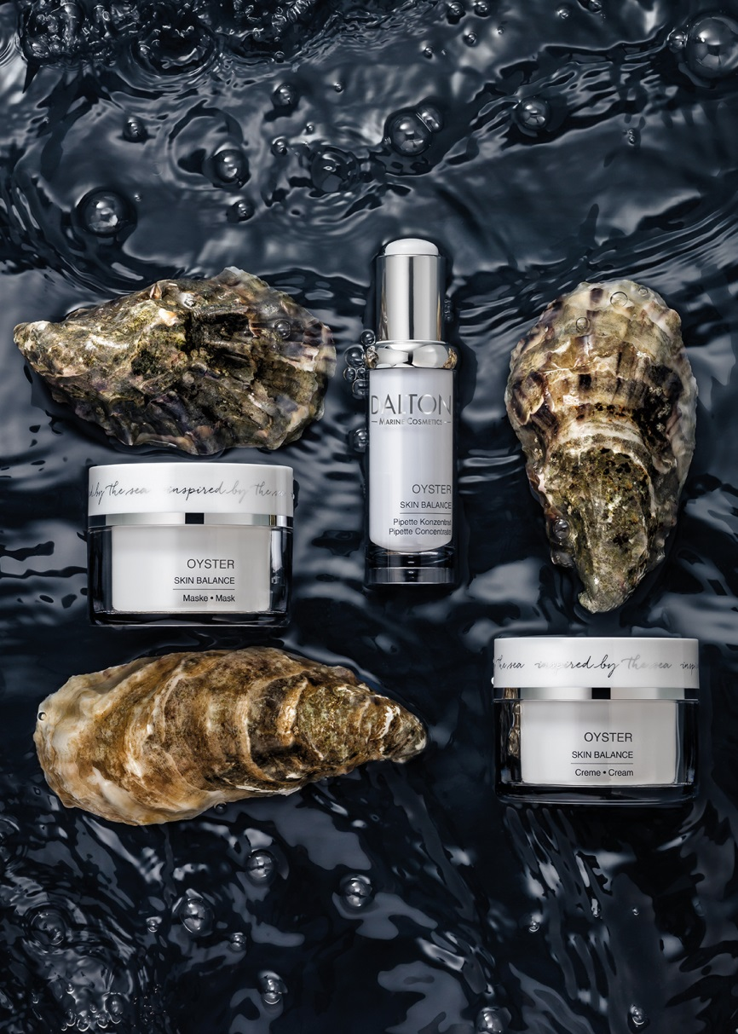
C O N C E P T
Especially recommended for large-pored and combination skin.
Additionally enriched with an extra portion of oyster for refined pores and a mattified complexion. The special formulation of the products also provides moisture and protects against skin aging due to free radicals.
That is why this line is recommended for keeping the skin healthy and as an aftercare for impure or acne-prone skin and sebaceous cysts.
For a refined, even complexion without looking oily.
For refined pores and a mattified complexion

Slide 3
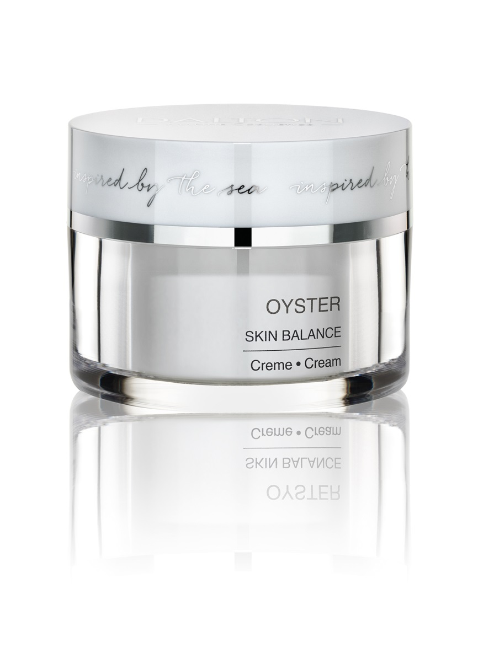
Cream
Balancing and pore-refining care cream for large-pored and combination skin.
Well-balanced, creamy texture
Balances excess sebum production in combination skin, helps to get rid of oily shine in the T-zone
Counteracts deposits
Pores are refined
Nourishes the skin
For a firmer and more even-toned complexion
For clear & plump skin
Ingr.

Slide 4
Cream - Active Ingredients
Celumer Marine Extract
Oyster
Pistacia lentiscus
Almond Oil
Vitamin E
Celumer Marine Extract
Oyster
Pistacia lentiscus
Almond Oil
Vitamin E
INCI
CREAM

Slide 5
Cream - INCI
Ingredients:
Aqua/Water, Caprylic/Capric Triglyceride, Dicaprylyl Carbonate, Glyceryl Stearate, PEG-100 Stearate, Propylene Glycol, Cetearyl Alcohol, Dimethicone, Glycerin, Prunus Amygdalus Dulcis (Sweet Almond) Oil, Pistacia Lentiscus (Mastic) Gum, Maris Aqua/Sea Water, Spirulina Maxima Extract, Algae Extract/Alaria Esculenta Extract, Saccharide Isomerate, Caviar Extract, Ostrea Shell Extract/Oyster Shell Extract, Maris Limus Extract/Sea Silt Extract, Tocopherol, Lecithin, Carbomer, Ethylhexylglycerin, Sodium Hydroxide, Potassium Sorbate, Hydrogenated Palm Glycerides Citrate, Tetrasodium Glutamate Diacetate, Phenoxyethanol, Cinnamyl Alcohol, Eugenol, Benzyl Salicylate, Hexyl Cinnamal, Limonene, Citronellol, Linalool, Alcohol, Parfum/Fragrance

Slide 6
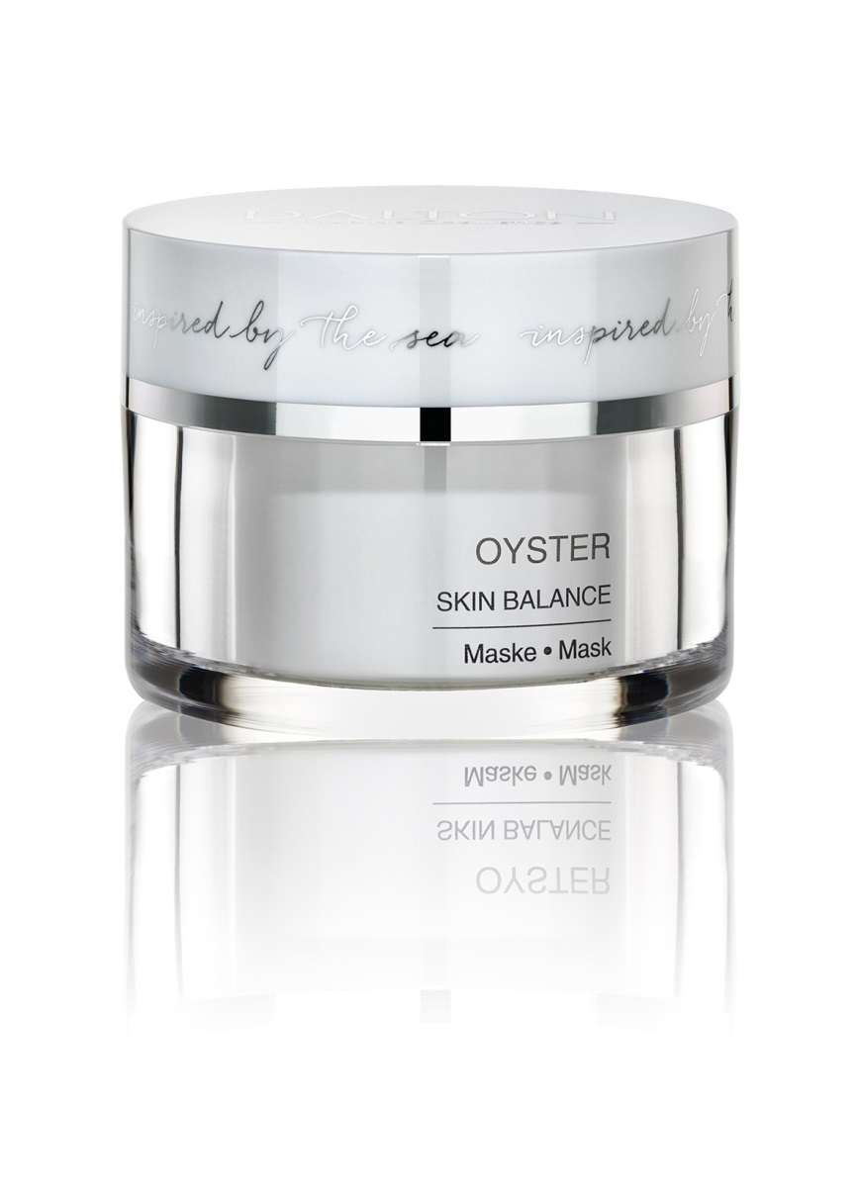
Mask
Mattifying and anti-inflammatory oyster mask for large-pored and combination skin.
Hardening texture (anthracite color)
Nutrient-rich and antibacterial formulation
Nourishes and cleans down to the pores
Improves shiny skin with an immediate effect
Leaves the skin with a clear and fresh appearance
For a matt complexion without drying out the skin
Tip:
Excellent SOS product; also for men‘s skin prone to impurities.
Intensive care for mature, impure skin
Ingr.

Slide 7
Mask - Active Ingredients
Celumer Marine Minerals
Sea Silt
Oyster
Pistacia lentiscus
Spirulina
Camphor
Kaolin
Celumer Marine Minerals
Sea Silt
Oyster
Pistacia lentiscus
Spirulina
Camphor
Kaolin
INCI
MASK

Slide 8
Mask - INCI
Ingredients:
Aqua (Water), Kaolin, Cetearyl Alcohol, Ceteareth-20, Octyldodecanol, Propylene Glycol, Stearic Acid, Magnesium Aluminum Silicate, Sorbitol, Palmitic Acid, Glycerin, Maris Aqua (Sea Water), Maris Limus (Sea Silt) Extract, Ostrea (Oyster) Shell Extract, Pistacia Lentiscus (Mastic) Gum, Spirulina Platensis Extract, Menthol, Lecithin, Camphor, Sodium Lactate, Potassium Sorbate, Sodium Hydroxide, Ethylhexylglycerin, Glyceryl Caprylate, Phenoxyethanol, Citral, Hydroxycitronellal, Alpha-Isomethyl Ionone, Limonene, Citronellol, Linalool, Alcohol, Parfum (Fragrance), CI 77499 (Iron Oxides)

Slide 9
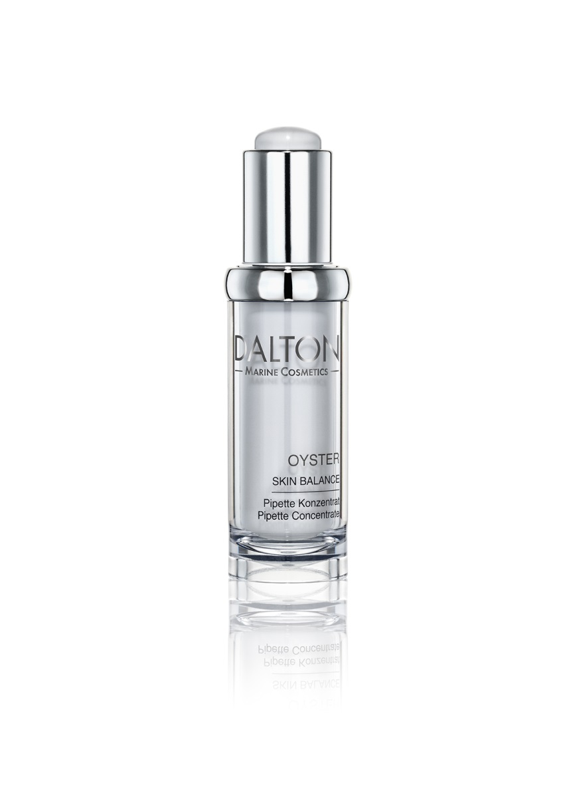
Pipette Concentrate
Pore-refining and intensively mattifying active concentrate for large-pored skin and combination skin.
Oily sheen is visibly and lastingly reduced
Leaves a beautiful, evenly mattified complexion
Tip:
Can be used locally(e.g. in the t-zone) as well as globally.
Ideal helper, if the skin produces more lipid due to hormonal changes (like during pregnancy)
Immediate help for mature, impure skin
Ingr.

Slide 10
Pipette Concentrate - Active Ingredients
Celumer Marine Extract
Oyster
Pistacia lentiscus
Hamamelis
Panthenol (Provitamin B5)
Lecithin (encapsulated)
Castor Oil
Celumer Marine Extract
Oyster
Pistacia lentiscus
Hamamelis
Panthenol
Lecitin
Castor Oil
INCI
PIPETTE CONCENTRATE

Slide 11
Pipette Concentrate - INCI
Ingredients:
Aqua/Water, Alcohol Denat. (SD Alcohol 39-C)/Alcohol Denat., Glycerin, Trideceth-9, PEG-40 Hydrogenated Castor Oil, Betaine, Maris Aqua/Sea Water, Spirulina Maxima Extract, Algae Extract/Alaria Esculenta Extract, Saccharide Isomerate, Caviar Extract, Ostrea Shell Extract/Oyster Shell Extract, Maris Limus Extract/Sea Silt Extract, Pistacia Lentiscus (Mastic) Gum, Hamamelis Virginiana (Witch Hazel) Water, Ammonium Glycyrrhizate, Chondrus Crispus Extract, Aesculus Hippocastanum (Horse Chestnut) Seed Extract, Yeast Extract, Ribes Nigrum (Black Currant) Fruit Extract, Panthenol, Biotin, Lecithin, Caffeine, Pectin, Niacinamide, Xanthan Gum, Potassium Sorbate, Zinc Gluconate, Propylene Glycol, Lactic Acid, Caprylic/Capric Triglyceride, Phenoxyethanol, Sodium Benzoate, Alcohol, Parfum/Fragrance

Slide 12
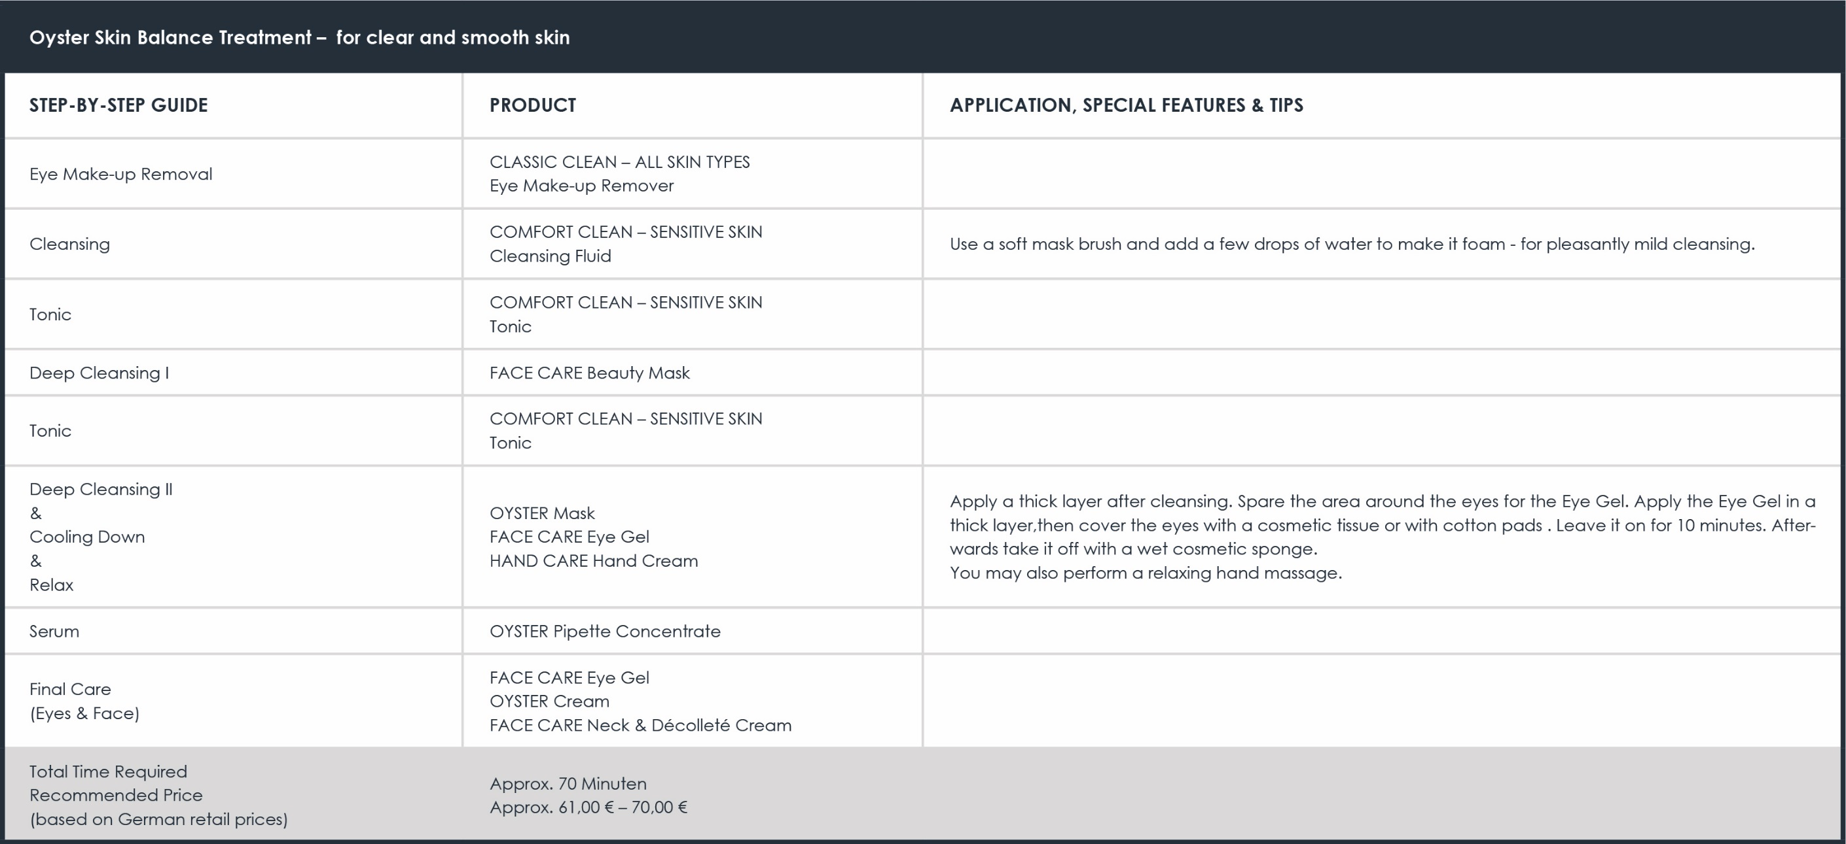

Slide 13
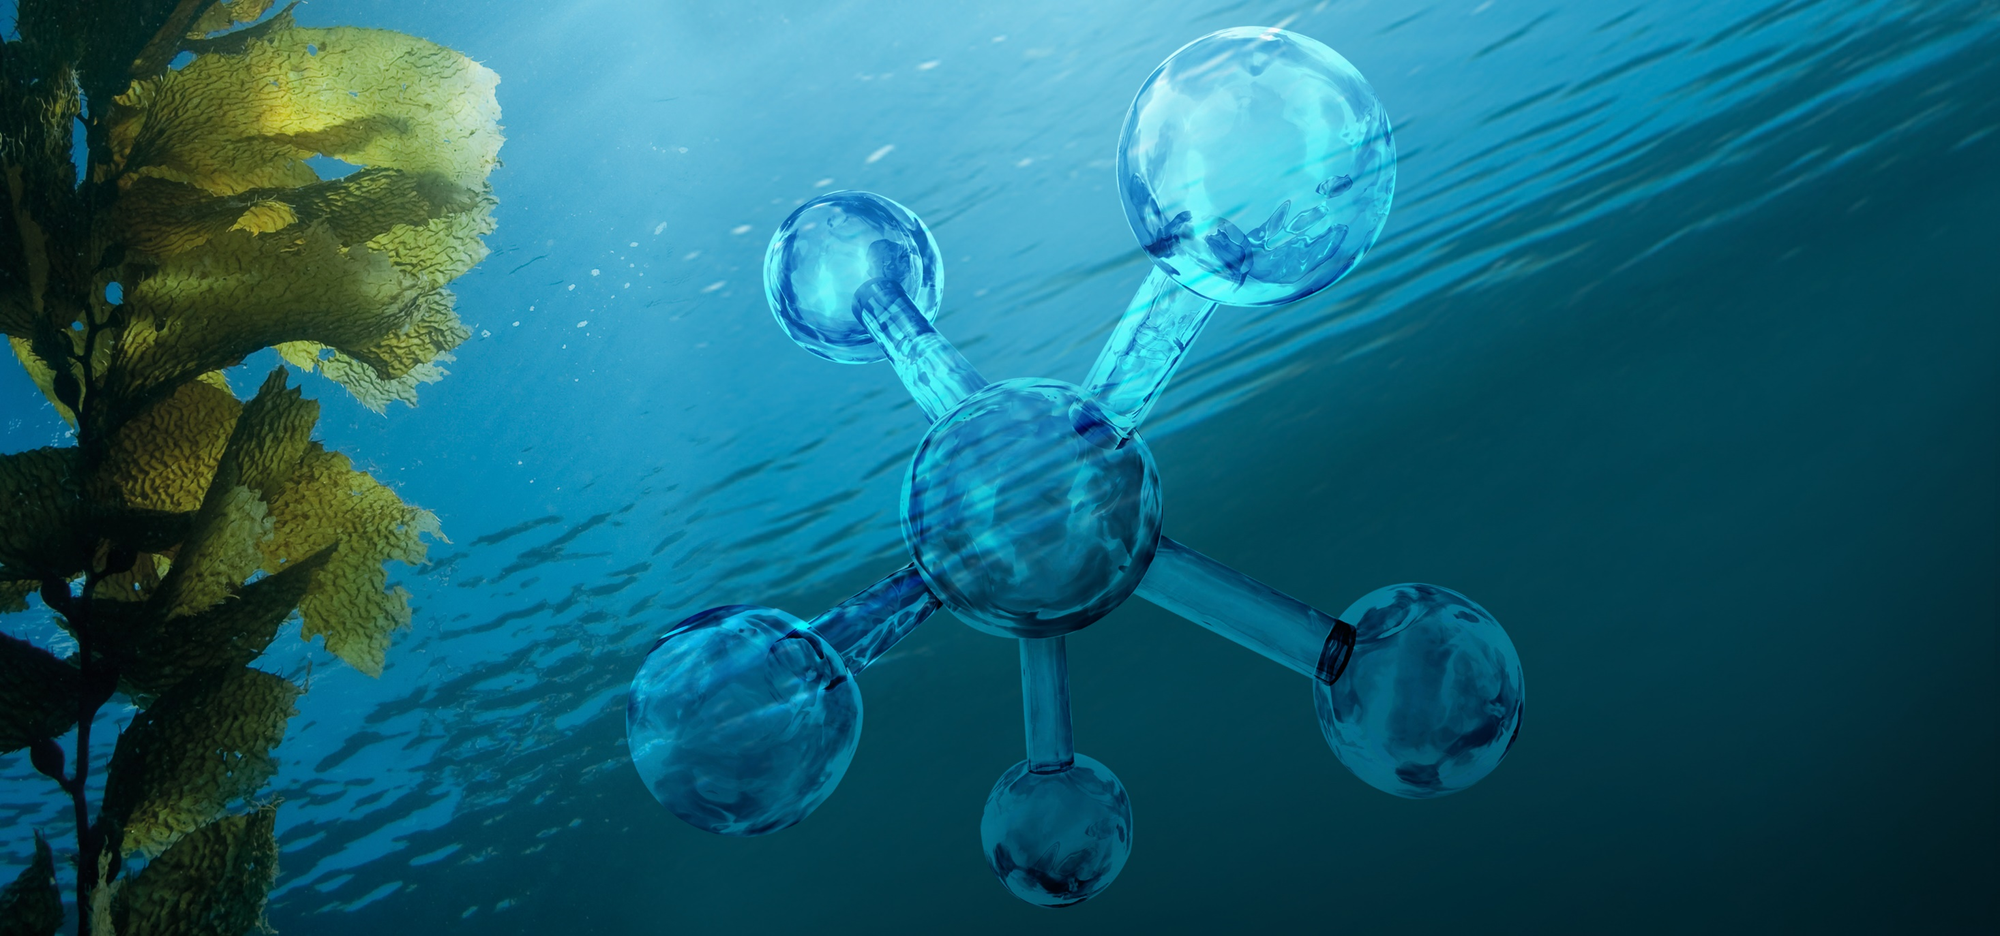
CELUMER MARINE EXTRACT
Shell
Algae
Seawater
Caviar
Plankton
Oyster

Slide 14
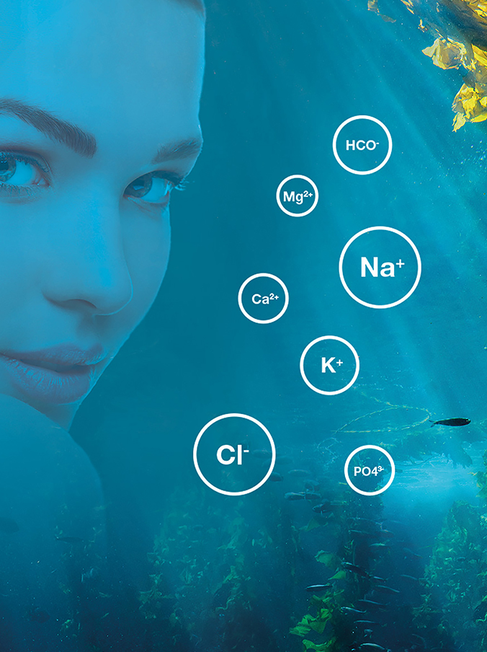
Celumer Marine Minerals
The composition of the Celumer Marine Minerals is similar to blood plasma, which allows for quicker absorption of active ingredients into deeper layers of the skin. As the combination is known to the body, they serve as a „means of transport“ for further active ingredients into the skin.
Cell supply
Better absorption of active ingredients
Very well tolerated by the skin

Slide 15
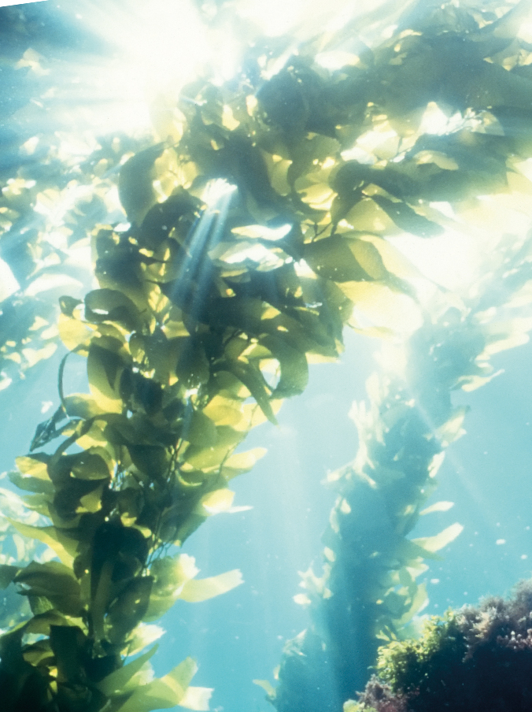
Algae
Algae are highly relevant in cosmetics. In order to grow and to proliferate, they need sunlight (photosynthesis) and nutrients, which they take from the environment they live in. That is why algae hold the entire richness of marine active agents. Additionaly, algae are able to withstand the currents of the sea and to survive with very little light. The Celumer Marine Extract uses the active ingredients of the brown- and blue algae. Algae are true multi-talents, when it comes to skin care:
Possess strong antioxidative properties for excellent cell protection
They protect the elastic fibers to keep the skin firm and youthful
Rich in nutrients like iron, beta carotine and unsaturated fatty acids
Intensively moisturizing and very well tolerated by the skin
The alga is one of the six interactive ingredients in our exclusive Celumer Marine Extract.

Slide 16
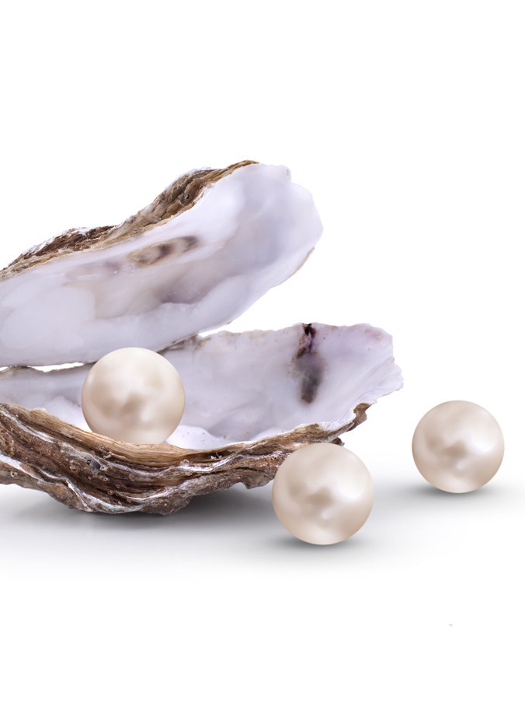
Oyster
Oysters (Ostreidae) have been around for over 250 million years, now as then celebrated as a culinary delicacy. Oysters contain a high amount of vitamins and minerals and offer high bioavailability with low caloric value. Oyster shell is often used in medical and cosmetic products, as it truly is a treasure chest of valuable skin-enhancers:
Amino acids and vitamins (B1, B2, B3, B5, B12) strengthen and nourish the skin
Valuable marine minerals & trace elements (potassium, phosphorus, natrium, zinc, calcium, magnesium, iron)vitalize the skin
For an even, mattified complexion
For healthy cell protection and beautiful, smooth skin
The oyster is one of the six interactive ingredients in our exclusive Celumer Marine Extract.

Slide 17
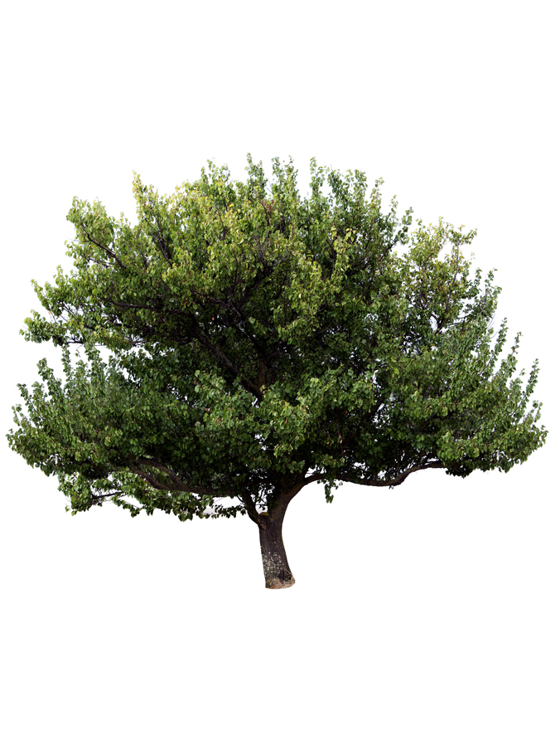
Camphor
Camphor is a lipophilic ingredient found in the essential oils of the camphor tree. The camphor tree is native to the Himalayas, where it thrives even at an altitude of more than 1000 meters. Camphor was used as a healing plant by Hildegard von Bingen, who used it to treat febrile diseases, rheumatism and colds. To this day, camphor is widely used for medicinal purposes, mainly in Asia.
Antiseptic
Anti-inflammatory
Bactericidal and antimicrobial

Slide 18
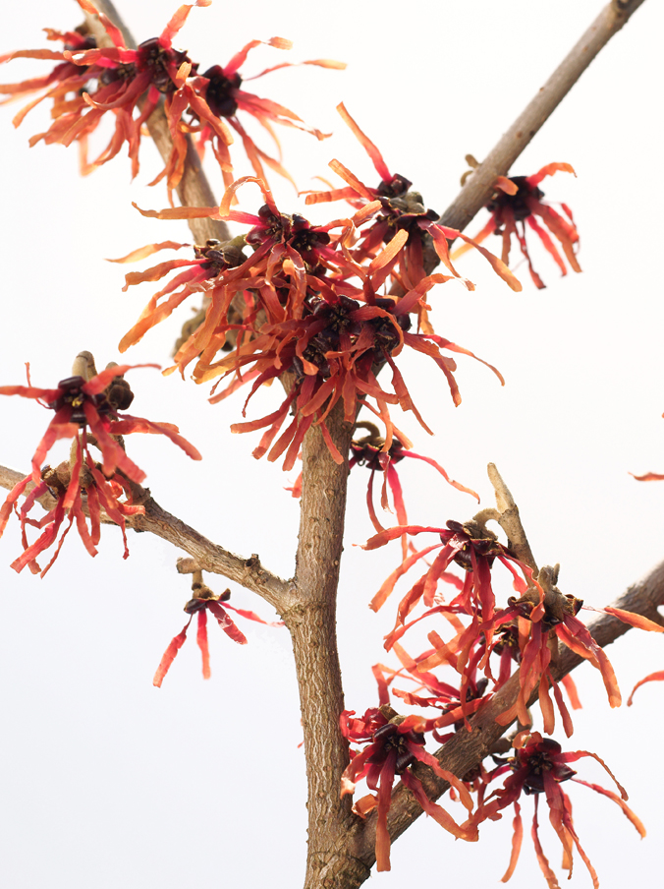
Hamamelis
An extract derived from the bark, leaves and twigs of the common witch hazel (Hamamelis virginiana). In addition to its traditional medicinal employment, the plant is cosmetically used because of its
skin conditioning
wound-healing
astringent
Soothing
properties.

Slide 19
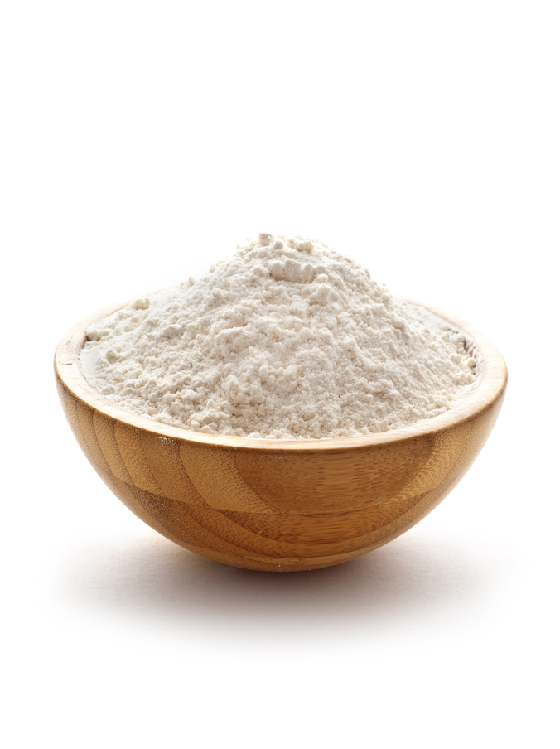
Kaolin
Kaolin, also known as porcelain clay, china clay, white clay or Bolus alba, is a fine, iron-free, white clay. Its main constituent is kaolinite (which is formed by weathering of feldspar).
Has detoxifying and cleansing properties („blotting paper effect“)
Refines pores
Calms and soothes
Is well tolerated by the skin

Slide 20
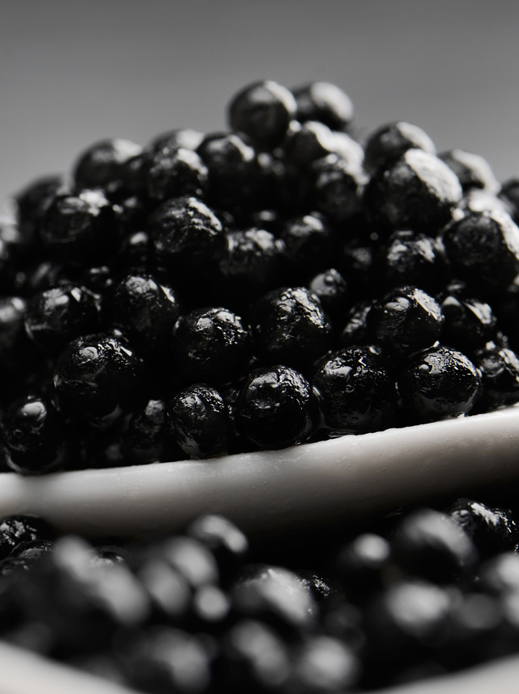
Caviar
Origin: Siberian sturgeon from sustainable, spezies-appropriate aquacultures in France.
In Germany, caviar is often called „the gold of the sea“. Over centuries, tsars, emperors and kings were ready to pay a lot of money for caviar and tried to get „exclusive rights“ to this delicacy. For its preservation, only pure salt is used.
Caviar has the following cosmetic benefits:
Contains a lot of proteins and unsaturated fatty acids
Moisturizing and nourishing for optimal skin protection
Protects the cell walls and enhances the bonding of skin cells with each other
Caviar is one of the six interactive ingredients in our exclusive Celumer Marine Extract.

Slide 21
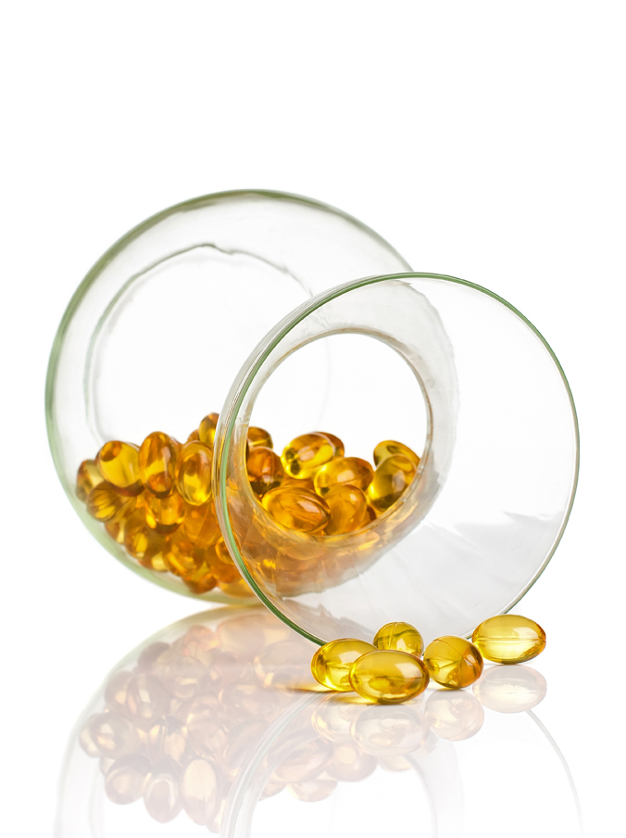
Lecithin (encapsulated)
The phospholipid lecithin is the main component of human cell membranes. In addition to its smoothing and lipid replenishing properties on the surface and in deeper layers of the skin, it helps the cell membrane achieve better cell protection and supports the absorption of healthy nutrients into the cell as well as the defense against free radicals and harmful substances. Lecithins in encapsulated form are vesicles (bubbles) that, in addition to their function as a component of the cell membrane, have the ability to transport water-soluble active agents.
Nutrients and active agents can be absorbed more easily into the skin
Supports the elimination of free radicals and other harmful substances
For optimal cell protection and a healthy cell membrane

Slide 22
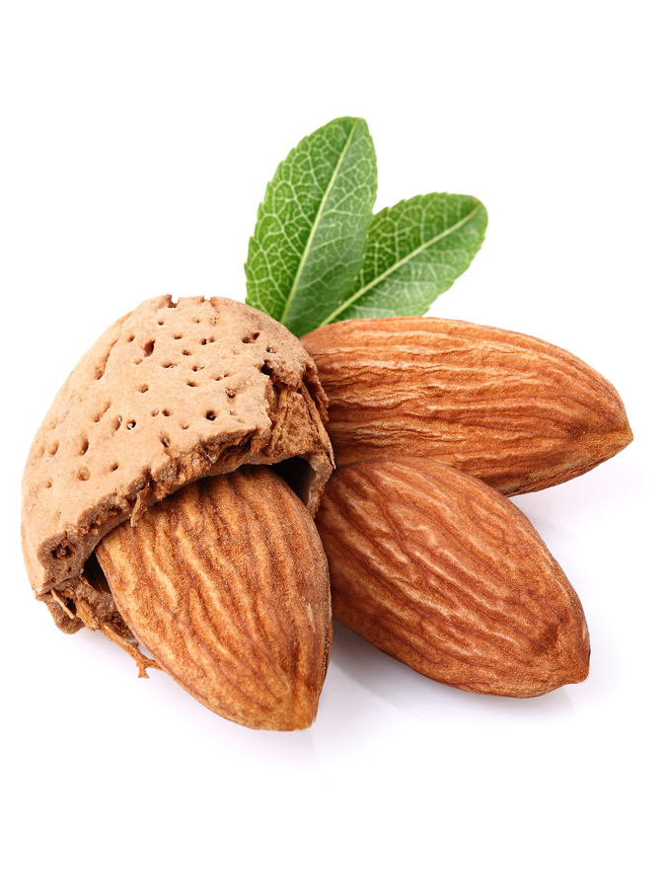
Almond Oil
The oil is well tolerated by the skin and therefore also suitable for use on problem skin
Delivers moisture and vitamins to the skin and, at the same time, protects skin against moisture loss
Helps make skin more resilient, thus reducing the appearance of fine lines and wrinkles

Slide 23
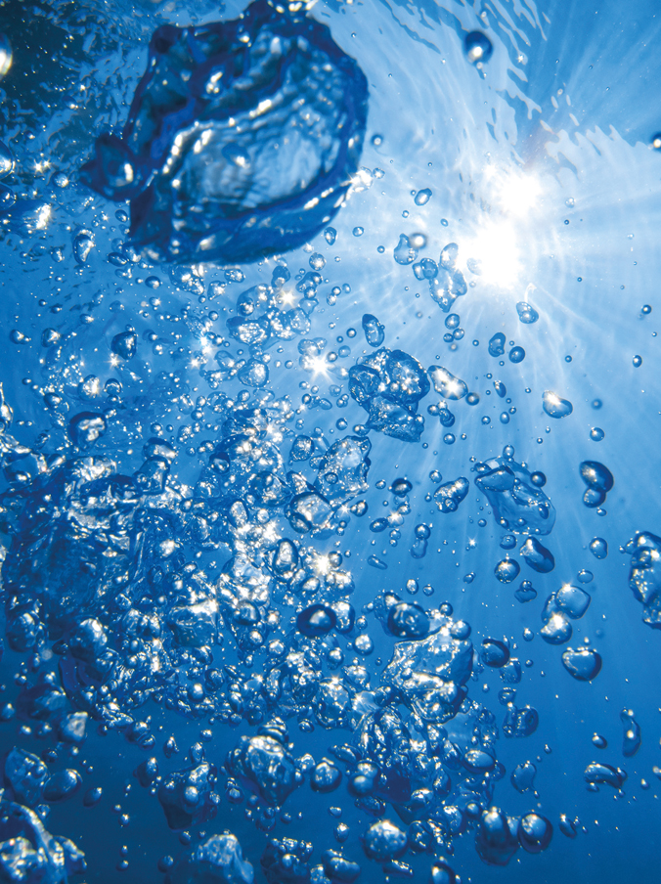
Seawater
Origin: Seawater from the French Atlantic coast. The seawater makes its way through granite formations and sandy layers and is won 22 meters below the surface.
The composition of its minerals and trace elements is amazingly similar to our blood plasma and lymphatic fluids, which makes it very relevant in cosmetics:
Moisturizing
Revitalizing
Strengthens cell communication by increasing lipid synthesis
Makes it easier and quicker to absorb active ingredients
Seawater is one of the six interactive ingredients in our exclusive Celumer Marine Extract.

Slide 24
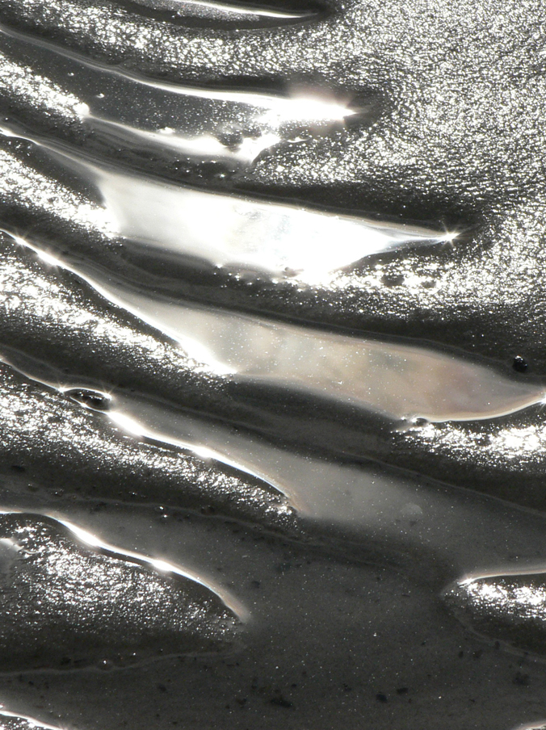
Sea Silt
Silt is a fine-grained sediment that can develop in all kinds of waters. Sea Silt is especially rich in vital nutrients; in a way it is the Healing Earth of the sea:
Optimal supply with mineral nutrients
Remineralising
Promotes healing
Strengthening

Slide 25
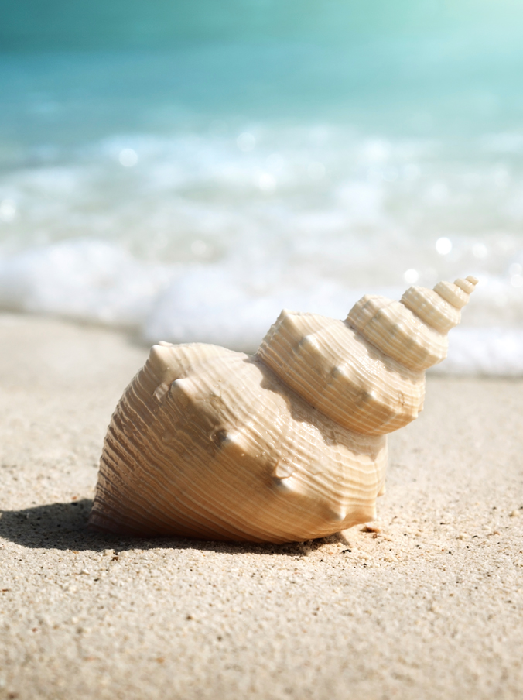
Shell
Origin: Shell sediment from the French Atlantic coast. Sustainably won at a depth of 30 meters.
They live at the bottom of the sea. Some are grown to riffs or the ground, some are floating above the sea bottom. Mussels are masters in the art of surviving - some live as long as 100 years. They obtain their food from the seawater, which gives them a whole variety of nutrients.
Cosmetic benefits of shells:
They are rich in calcium carbonate
They have a detoxifying effect
Strengthen the connective tissue
Remineralise, regenerate and nurture
The shell is one of the six interactive ingredients in our exclusive Celumer Marine Extract.

Slide 26
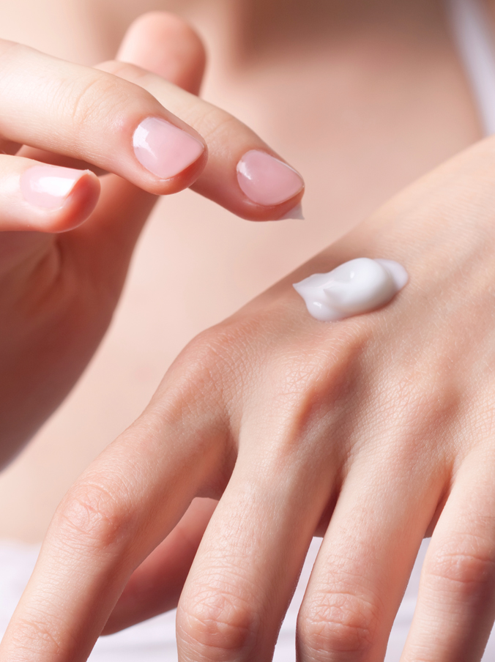
Panthenol (Provitamin B5)
Panthenol is a provitamin (vitamin precursor). It may be converted in the body to panthothenic acid(vitamin B5). This soothing active ingredient is very often used in ointments and salves. Panthenol is popular in cosmetics due to the following beneficial properties:
Assists the skin in retaining moisture
Helps enhance skin elasticity
Offers anti-inflammatory and soothing properties
Promotes skin cell renewal (epithelialization)
Is very well tolerated by the skin

Slide 27
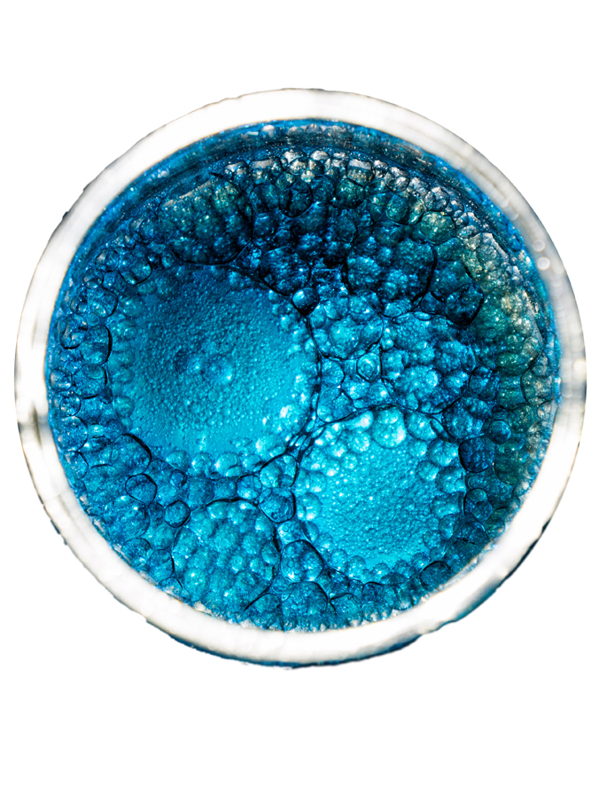
Plankton
Origin: Northwest France, won at an estuary, where fresh water and salt water meet and mix. That is why the ecosystem is especially healthy and characterised by variety.
Plankton are microscopic organisms that float in great numbers in the sea. They absorb carbon dioxide and sunlight to produce energy for healthy growth and metabolism. Excessive exposure of plankton to solar UV radiation results in the formation of an enyzme that is able to repair UV light induced cell damage. The essential nutrients contained in plankton are true all-rounders!
Accelerate the differentiation of skin cells for more freshness and youthfulness
Possess antibacterial properties, which strengthens the skin‘s protective barrier
Protect against UV-induced oxidation, thus discouraging premature skin aging
Plankton is one of the six interactive ingredients in our exclusive Celumer Marine Extract.

Slide 28
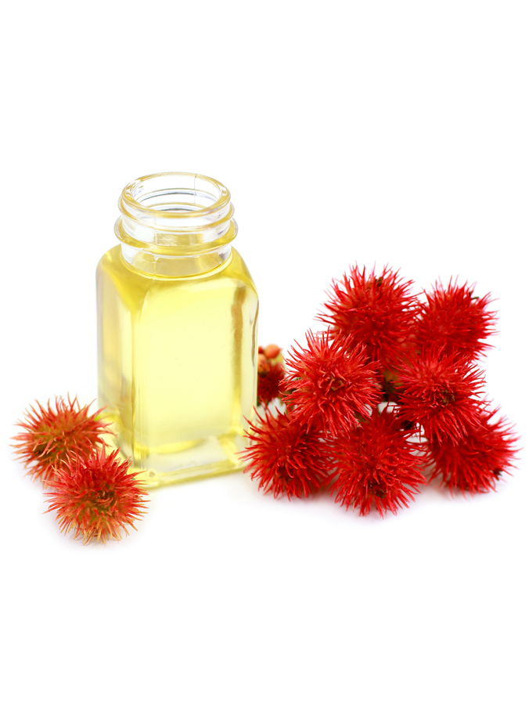
Castor Oil
Castor oil is obtained from the seeds of the castor oil plant(Ricinus communis). In ancient times, castor oil was commonly used as a medical remedy. Today, it offers these properties in skin care:
Protects against harmful environmental influences
Stimulates collagen synthesis
Improves skin firmness and reduces wrinkles
Ideal for the treatment of scarred tissue, keeping it soft and more supple

Slide 29
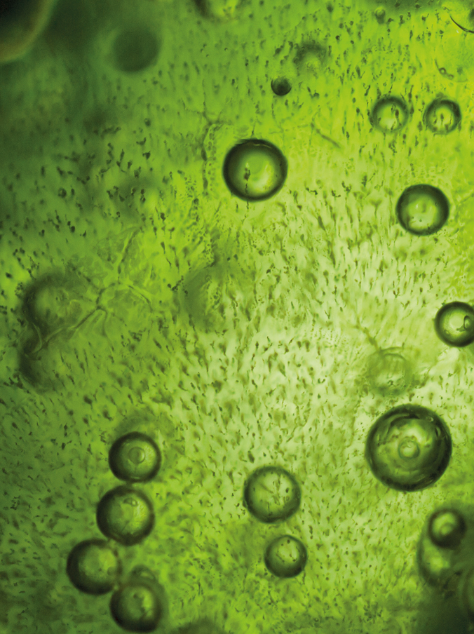
Spirulina
Spirulina is a genus of blue-green algae (cyanobacteria) and occurs naturally in lakes with high pH (9 -11). It is native to Central America, Africa, Australia and Southeast Asia and can primarily be found in shallow waters with high salt levels. In addition to its use as a food supplement, spirulina has many cosmetic benefits:
High levels of polyunsaturated fatty acids
Rich in proteins and essential amino acids
Rich in mineral nutrients and antioxidants like vitamins E, B1, B12 and beta-Carotene
Regulates cellular energy processes and, as a result, supports cell renewal

Slide 30
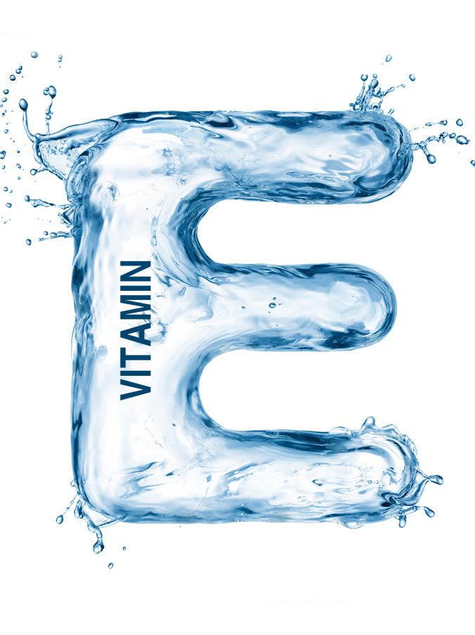
Vitamin E
Vitamin E is not just a single substance, but a whole family of fat-soluble nutrients. However, the term vitamin E is generally used for α-tocopherol, the best-researched form of vitamin E. The body obtains vitamin E through dietary intake. The richest sources of vitamin E are vegetable oils. Vitamin E was first discovered as a ‘fertility vitamin’ by US researchers Herbert M. Evans and Katherine S. Bishop in 1922. In the following years, the vitamin was isolated from wheat germ oil, corn and oats. Since vitamins A, B, C and D were already discovered, tocopherol was given the name vitamin E.
Anti-aging vitamin
Strong antioxidant effect -> protects the cells
Improves the epithelialization of the skin and its ability to retain moisture

Slide 31
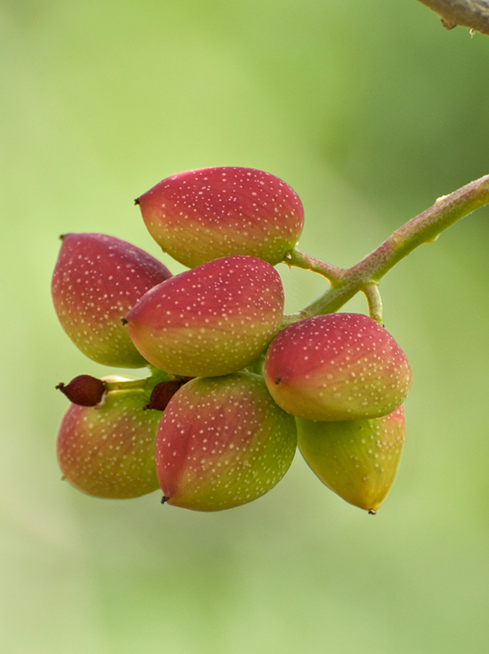
Pistacia lentiscus
Pistacia lentiscus, also called „mastic“, belongs to the cashew family (Anacardiaceae). The mastic shrub grows in the Mediterranean area and reaches a height of 1 to 3 meters. It has been highly prized for its resin, which is still cultivated today, for example in Greece. Extracts from Pistacia lentiscus have an age-old tradition as active ingredients and are still used as a spice, as medicine and also as cosmetic ingredients. Their impressive, visible effect is as follows:
• Antibacterial and anti-inflammatory
• Astringent, provides a pore-refining effect
• Reduces oily shine and mattifies the skin

Slide 32
COPYRIGHT & DISCLAIMER
COPYRIGHT. All pictures and images, the presentation design and the content provided in this training material are subject to copyright law and intellectual property protection and may only be used for the training of authorized DALTON aestheticians. Any distribution (analog/digital) or the use of any text or image requires the prior written consent of DALTON COSMETICS GERMANY GmbH.
DISCLAIMER. This training material forms part of the theoretical and practical training concept of DALTON COSMETICS GERMANY GmbH and requires further verbal explanation and practical experience to be complete. Therefore, DALTON COSMETICS GERMANY GmbH cannot be held liable for the completeness of the information provided herein.
DALTON COSMETICS GERMANY GmbH
Schulungsabteilung / Training Centre
Hauptstr.6, 94571 Schaufling, Deutschland / Germany

