Slide 1
CONCEPT
Cream
Emulsion
Serum
Eye Cream
Ampoule
Mask
IN-SALON TREATMENT

Slide 2
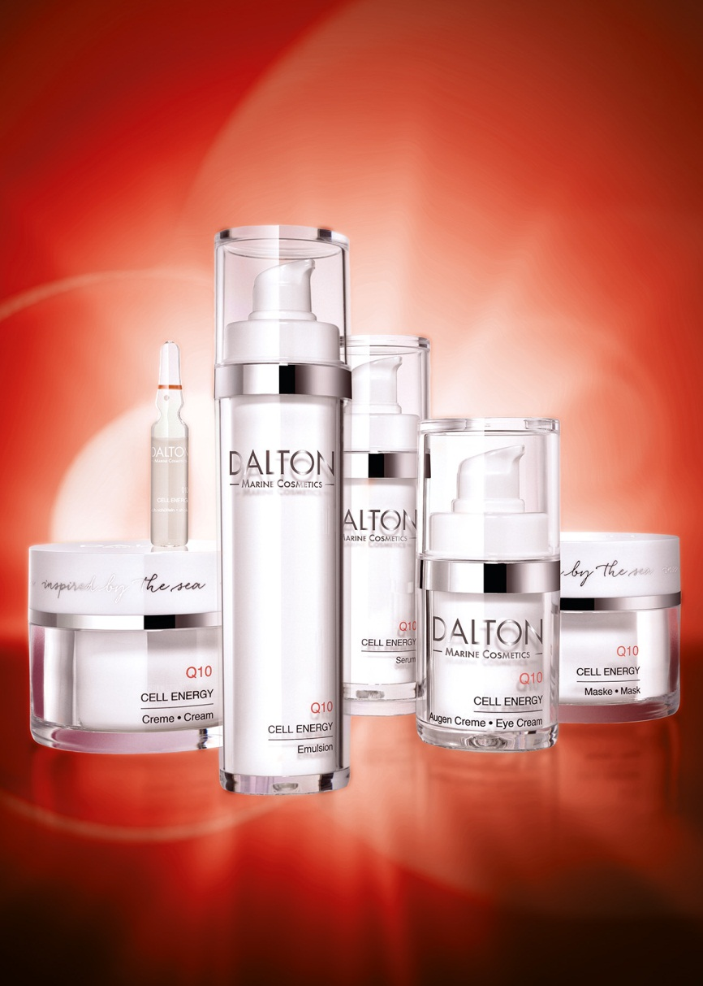
C O N C E P T
For our Q10 line, the Celumer Marine Extract is enriched with the vitalizing active agent Q10 for a fresh complexion and a dynamic appearance.
Activates the cell renewal process
For a noticeable improvement of cell activity
For optimal cell nourishment
For a youthful dynamic
For increased performance
For a fresh and vital complexion
For tired and stressed skin

Slide 3
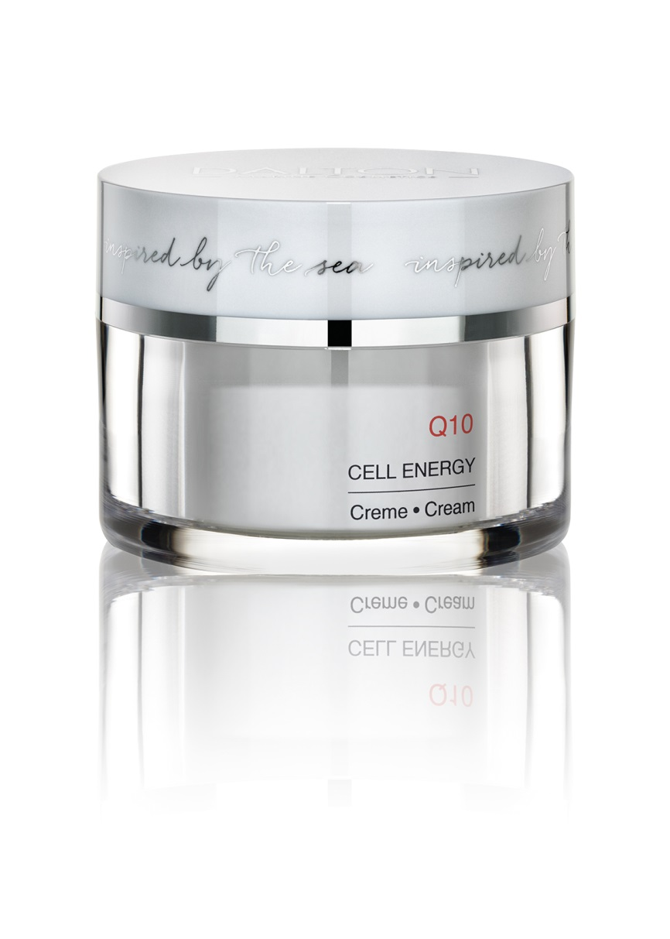
Cream
Rich texture with Q10 active pearls
For tired and stressed skin
Smoothes demanding, mature skin
For new cell energy
For a fresh appearance
For a vital complexion
TIP:
Perfect skin care in winter – for protection and a radiant look, all in one!
Tired, demanding, mature skin
Ingr.

Slide 4
Cream - Active Ingredients
Celumer Marine Extract
Q10
Hyaluronic Acid
Jojoba Oil
Celumer Marine Extract
Q10
Hyaluronic Acid
Jojoba Oil
INCI
CREAM

Slide 5
Cream - INCI
Ingredients:
Aqua/Water, Decyl Oleate, Caprylic/Capric Triglyceride, Glyceryl Stearate, Sorbitol, PEG-100 Stearate, Propylene Glycol, Cetearyl Alcohol, Ubiquinone, Maris Aqua/Sea Water, Spirulina Maxima Extract, Algae Extract/Alaria Esculenta Extract, Saccharide Isomerate, Caviar Extract, Ostrea Shell Extract/Oyster Shell Extract, Maris Limus Extract/Sea Silt Extract, Sodium Hyaluronate, Simmondsia Chinensis (Jojoba) Seed Oil, Panthenol, Tocopherol, Allantoin, Tocopheryl Acetate, Lecithin, Carnitine, Algin, Pentylene Glycol, Caprylyl Glycol, Agar, Sodium Hydroxide, Glycerin, Ethylhexylglycerin, Citric Acid, Dimethicone, Tetrasodium Glutamate Diacetate, Potassium Sorbate, Disodium EDTA, Trisodium EDTA, Lactic Acid, Phenoxyethanol, Xanthan Gum, Myristyl Alcohol, Benzyl Salicylate, Hydrogenated Palm Glycerides Citrate, Butylphenyl Methylpropional, Eugenol, Hexyl Cinnamal, Alpha-Isomethyl Ionone, Citronellol, Limonene, Linalool, Parfum/Fragrance, Red 30 (CI 73360)

Slide 6
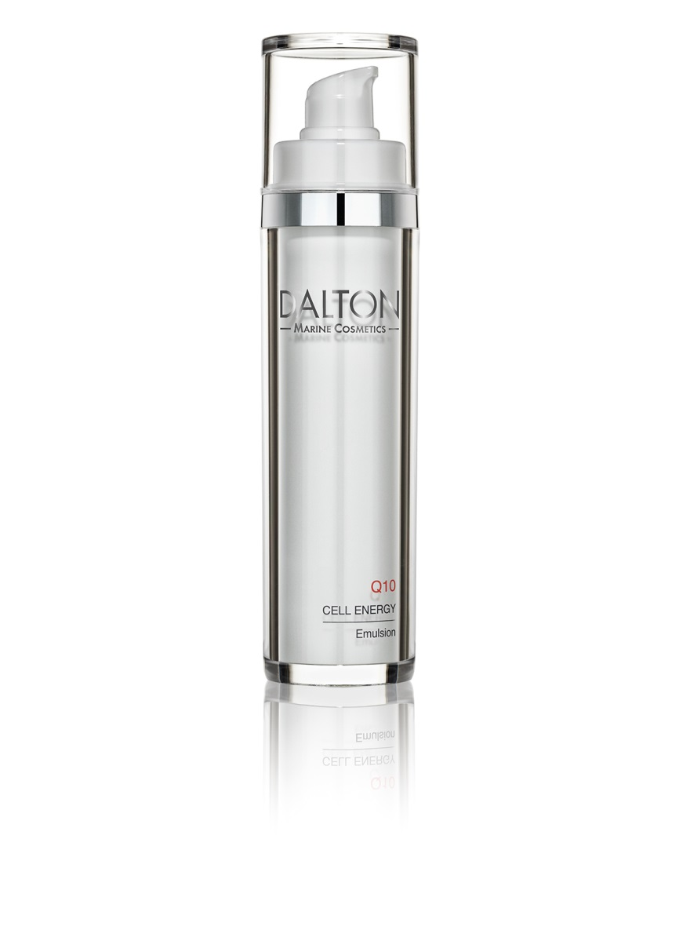
Emulsion
Light cream texture with Q10 active pearls
For tired and stressed skin
For new cell energy
For a fresh appearance
For a vital complexion
TIP:
Perfect skin care in summer – provides moisture and a radiant look, all in one!
.
Tired, dry and combination skin
Ingr.

Slide 7
Emulsion - Active Ingredients
Celumer Marine Extract
Q10
Hyaluronic Acid
Almond Oil
Celumer Marine Extract
Q10
Hyaluronic Acid
Almond Oil
INCI
EMULSION

Slide 8
Emulsion - INCI
Ingredients:
Aqua (Water), Decyl Oleate, Dicaprylyl Carbonate, Glyceryl Stearate, PEG-100 Stearate, Dimethicone, Propylene Glycol, Diethylhexyl Carbonate, Prunus Amygdalus Dulcis (Sweet Almond) Oil, Sorbitol, Sodium Polyacrylate, Cetearyl Alcohol, Ubiquinone, Maris Aqua (Sea Water), Spirulina Maxima Extract, Algae Extract, Saccharide Isomerate, Caviar Extract, Ostrea (Oyster) Shell Extract, Maris Limus (Sea Silt) Extract, Panthenol, Sodium Hyaluronate, Simmondsia Chinensis (Jojoba) Seed Oil, Allantoin, Lecithin, Tocopherol, Tocopheryl Acetate, Glycerin, Sodium Hydroxide, Agar, Citric Acid, Pentylene Glycol, Potassium Sorbate, Ethylhexylglycerin, Tetrasodium Glutamate Diacetate, Carnitine, Algin, Xanthan Gum, Hydrogenated Coco-Glycerides, Glyceryl Caprylate, Caprylic/Capric Triglyceride, Phenoxyethanol, Trisodium EDTA, Eugenol, Benzyl Salicylate, Butylphenyl Methylpropional, Hydrogenated Palm Glycerides Citrate, Hexyl Cinnamal, Linalool, Citronellol, Limonene, Alpha-Isomethyl Ionone, Parfum (Fragrance), CI 73360 (Red 30)

Slide 9
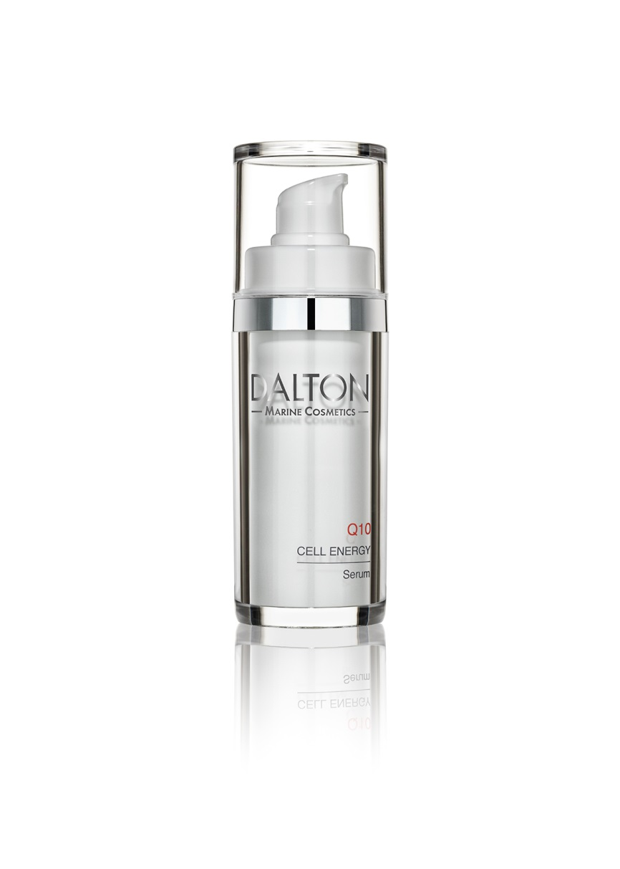
Serum
Gel texture with Q10 active pearls
Intensive care for tired and stressed skin
Is quickly absorbed and does not leave an oily shine
Especially recommended as daily care for mature, demanding skin
TIP:
In times of stress or when the skin is exposed to negative environmental influences, a curative treatment is recommended even for normal skin.
The daily energy kick
Ingr.

Slide 10
Serum - Active Ingredients
Celumer Marine Extract
Q10
Japanese Blood Grass
Vitamin E
Celumer Marine Extract
Q10
Japanese Blood Grass
Vitamin E
INCI
SERUM

Slide 11
Serum - INCI
Ingredients:
Aqua/Water, Pentylene Glycol, Sorbitol, Glycerin, Imperata Cylindrica Root Extract, Ubiquinone, Maris Aqua/Sea Water, Spirulina Maxima Extract, Algae Extract/Alaria Esculenta Extract, Saccharide Isomerate, Caviar Extract, Ostrea Shell Extract/Oyster Shell Extract, Maris Limus Extract/Sea Silt Extract, Sodium Hyaluronate, Simmondsia Chinensis (Jojoba) Seed Oil, Tocopherol, Lecithin, Algin, Agar, Carnitine, Carbomer, Xanthan Gum, Sodium Hydroxide, Sodium Benzoate, Potassium Sorbate, Caprylyl Glycol, Propylene Glycol, Ethylhexylglycerin, Caprylic/Capric Triglyceride, Phenoxyethanol, Trisodium EDTA, Acrylates/C10-30 Alkyl Acrylate Crosspolymer, Alpha-Isomethyl Ionone, Butylphenyl Methylpropional, Hexyl Cinnamal, Parfum/Fragrance, Red 30 (CI 73360)

Slide 12
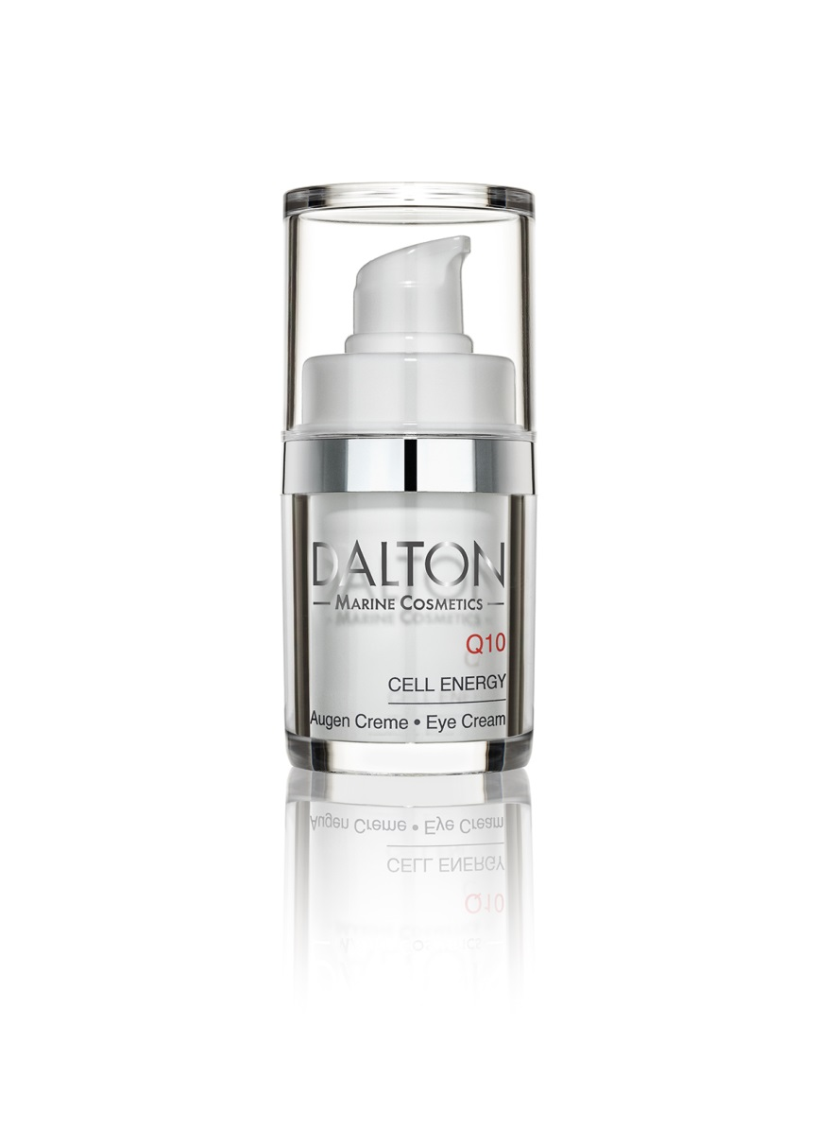
Eye Cream
Fine creamy texture
For tired and stressed skin
Tightening and energizing
Makes mimic lines smoother
Stimulates cell renewal
Also suitable for wearers of glasses and contact lenses
TIP:
Perfect eye care product for office workers !
Vitalizing care for the eyes
Ingr.

Slide 13
Eye Cream - Active Ingredients
Celumer Marine Extract
Q10
Castor Oil
Vitamin E
Celumer Marine Extract
Q10
Castor Oil
Vitamin E
INCI
EYE CREAM

Slide 14
Eye Cream - INCI
Ingredients:
Aqua/Water, Propylene Glycol, Pentylene Glycol, C12-15 Alkyl Benzoate, Ricinus Communis (Castor) Seed Oil, PEG-100 Stearate, Myristyl Alcohol, Glyceryl Stearate, Cera Alba/Beeswax, Maris Aqua/Sea Water, Ubiquinone, Spirulina Maxima Extract, Algae Extract/Alaria Esculenta Extract, Saccharide Isomerate, Caviar Extract, Ostrea Shell Extract/Oyster Shell Extract, Maris Limus Extract/Sea Silt Extract, Helianthus Annuus (Sunflower) Seed Oil, Tocopherol, Glycerin, Carbomer, Lecithin, Sodium Hydroxide, Carnitine, Potassium Sorbate, Trisodium EDTA, Caprylic/Capric Triglyceride, Phenoxyethanol, Alpha-Isomethyl Ionone, Hexyl Cinnamal, Butylphenyl Methylpropional, Benzyl Salicylate, Linalool, Limonene, Citronellol, Eugenol, Parfum/Fragrance

Slide 15
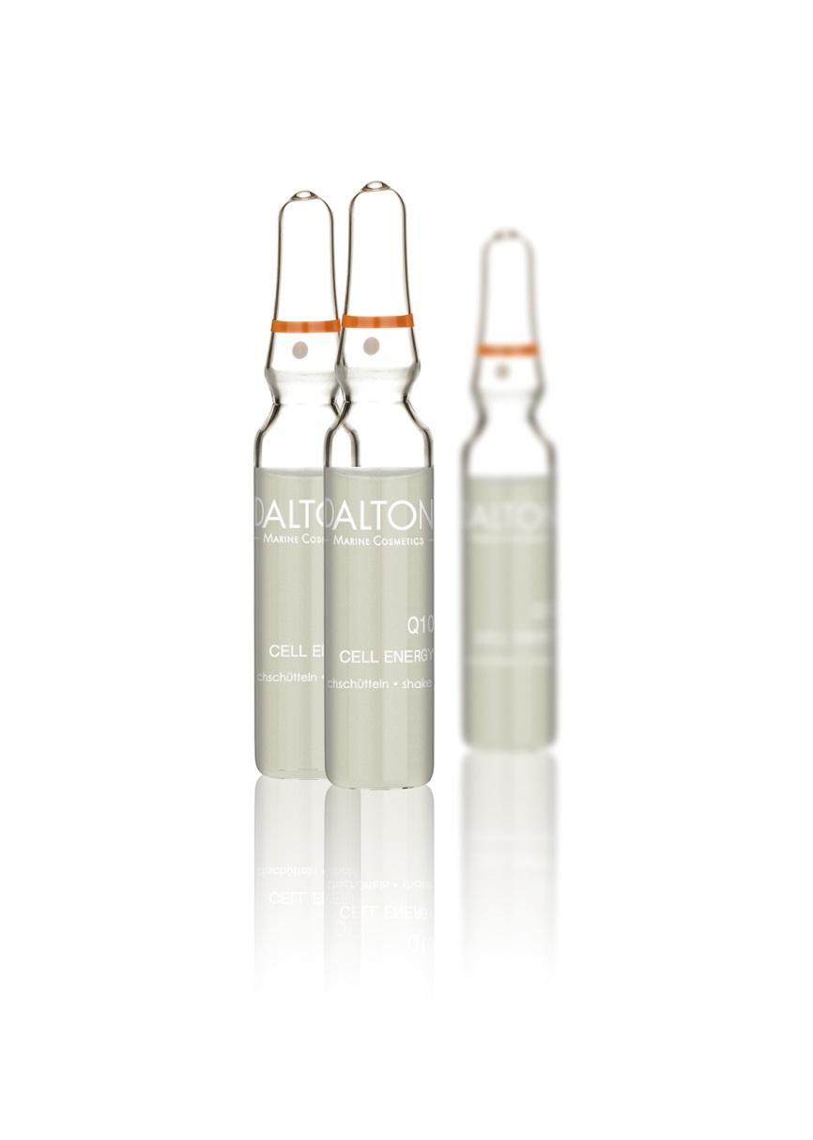
Ampoule
Active concentrate for maximum cell energy
For a kick of freshness
Increases the skin‘s natural reserves of Q10
Promotes cell activity
TIP:
Quick energy boost whenever it is needed the most (e.g. job interview or blind date)
The ultimate kick of energy and freshness
Ingr.

Slide 16
Ampoule - Active Ingredients
Celumer Marine Extract
Q10
Vitamin E
Celumer Marine Extract
Q10
Vitamin E
INCI
AMPOULE

Slide 17
Ampoule - INCI
Ingredients:
Aqua (Water), Propylene Glycol, Pentylene Glycol, Butylene Glycol, Maris Aqua (Sea Water), PEG-40 Hydrogenated Castor Oil, Ubiquinone, Spirulina Maxima Extract, Algae Extract, Saccharide Isomerate, Caviar Extract, Ostrea (Oyster) Shell Extract, Maris Limus (Sea Silt) Extract, Sodium Hyaluronate, Lecithin, Tocopherol, Carnitine, Glycerin, Menthyl Lactate, Potassium Sorbate, Caprylic/Capric Triglyceride, Sodium Hydroxide, Phenoxyethanol, Hexyl Cinnamal, Trisodium EDTA, Alpha-Isomethyl Ionone, Butylphenyl Methylpropional, Acrylates/C10-30 Alkyl Acrylate Crosspolymer, Linalool, Limonene, Benzyl Salicylate, Parfum (Fragrance)

Slide 18
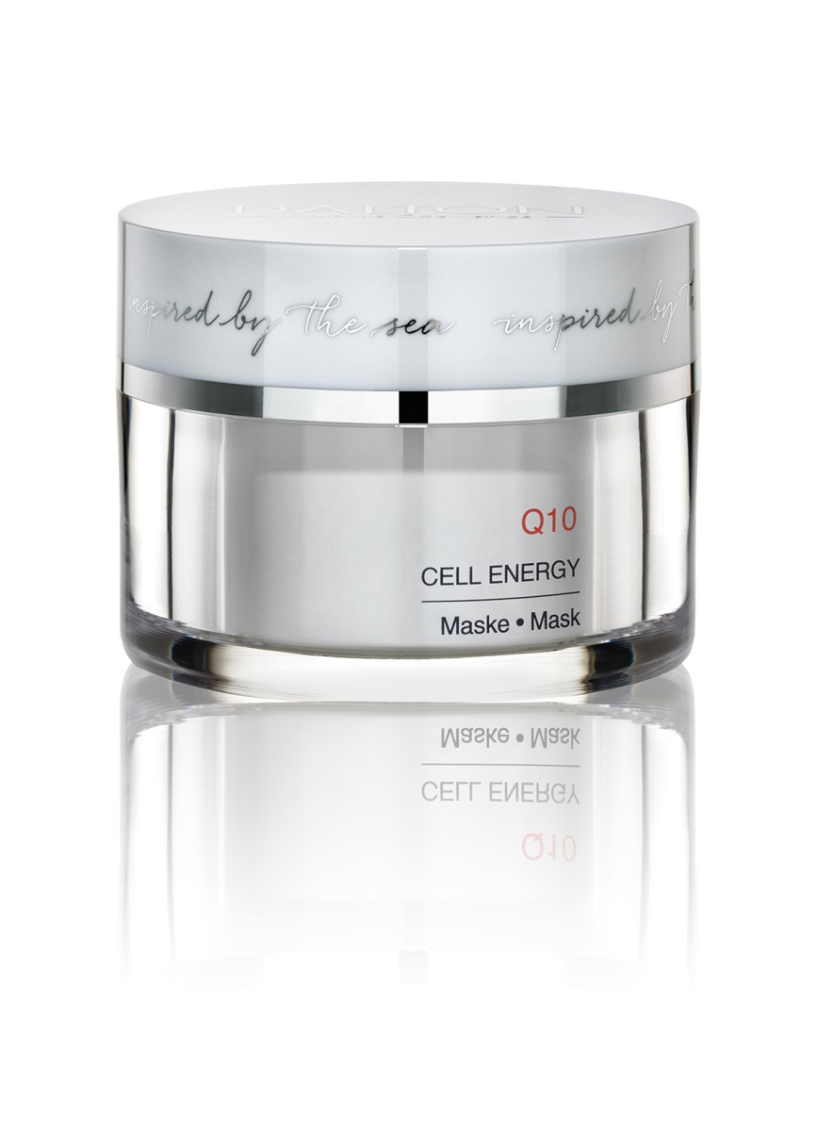
Mask
Refreshing cream mask with Q10 active pearls
For a refreshing cooling effect
Provides important vital substances and cell energy
Acts as an immediate energy boost
Protection against free radicals
Reduces mimic lines
For a kick of freshness
For a fresh and rosy complexion
TIP:
Can be left on the skin over night, as intensive treatment!
Energy kick & intensive care
Ingr.

Slide 19
Mask - Active Ingredients
Celumer Marine Minerals
Q10
Japanese Blood Grass
Vitamin E
Almond Oil
Squalane
Celumer Marine Minerals
Q10
Japanese Blood Grass
Vitamin E
 Almond Oil
Squalane
INCI
MASK

Slide 20
Mask - INCI
Ingredients:
Aqua (Water), Prunus Amygdalus Dulcis (Sweet Almond) Oil, Decyl Oleate, Cetearyl Alcohol, Glycerin, Sorbitol, Glyceryl Stearate, PEG-100 Stearate, Pentylene Glycol, Squalane, Imperata Cylindrica Root Extract, Maris Aqua (Sea Water), Ubiquinone, Simmondsia Chinensis (Jojoba) Seed Oil, Tocopherol, Sodium Carbomer, Algin, Lecithin, Carnitine, Sodium Hydroxide, Agar, Potassium Sorbate, Tetrasodium Glutamate Diacetate, Ethylhexylglycerin, Caprylyl Glycol, Tocopheryl Acetate, Dimethicone, Menthyl Lactate, Lactic Acid, Carbomer, Phenoxyethanol, Hydrogenated Palm Glycerides Citrate, Acrylates/C10-30 Alkyl Acrylate Crosspolymer, Trisodium EDTA, Eugenol, Limonene, Hexyl Cinnamal, Alpha-Isomethyl Ionone, Benzyl Salicylate, Citronellol, Linalool, Butylphenyl Methylpropional, CI 73360 (Red 30), Parfum (Fragrance)

Slide 21
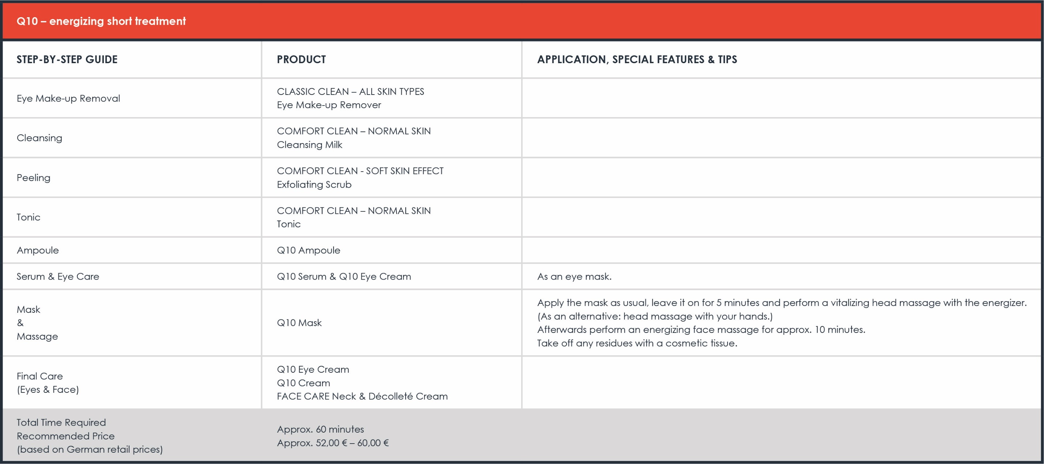

Slide 22
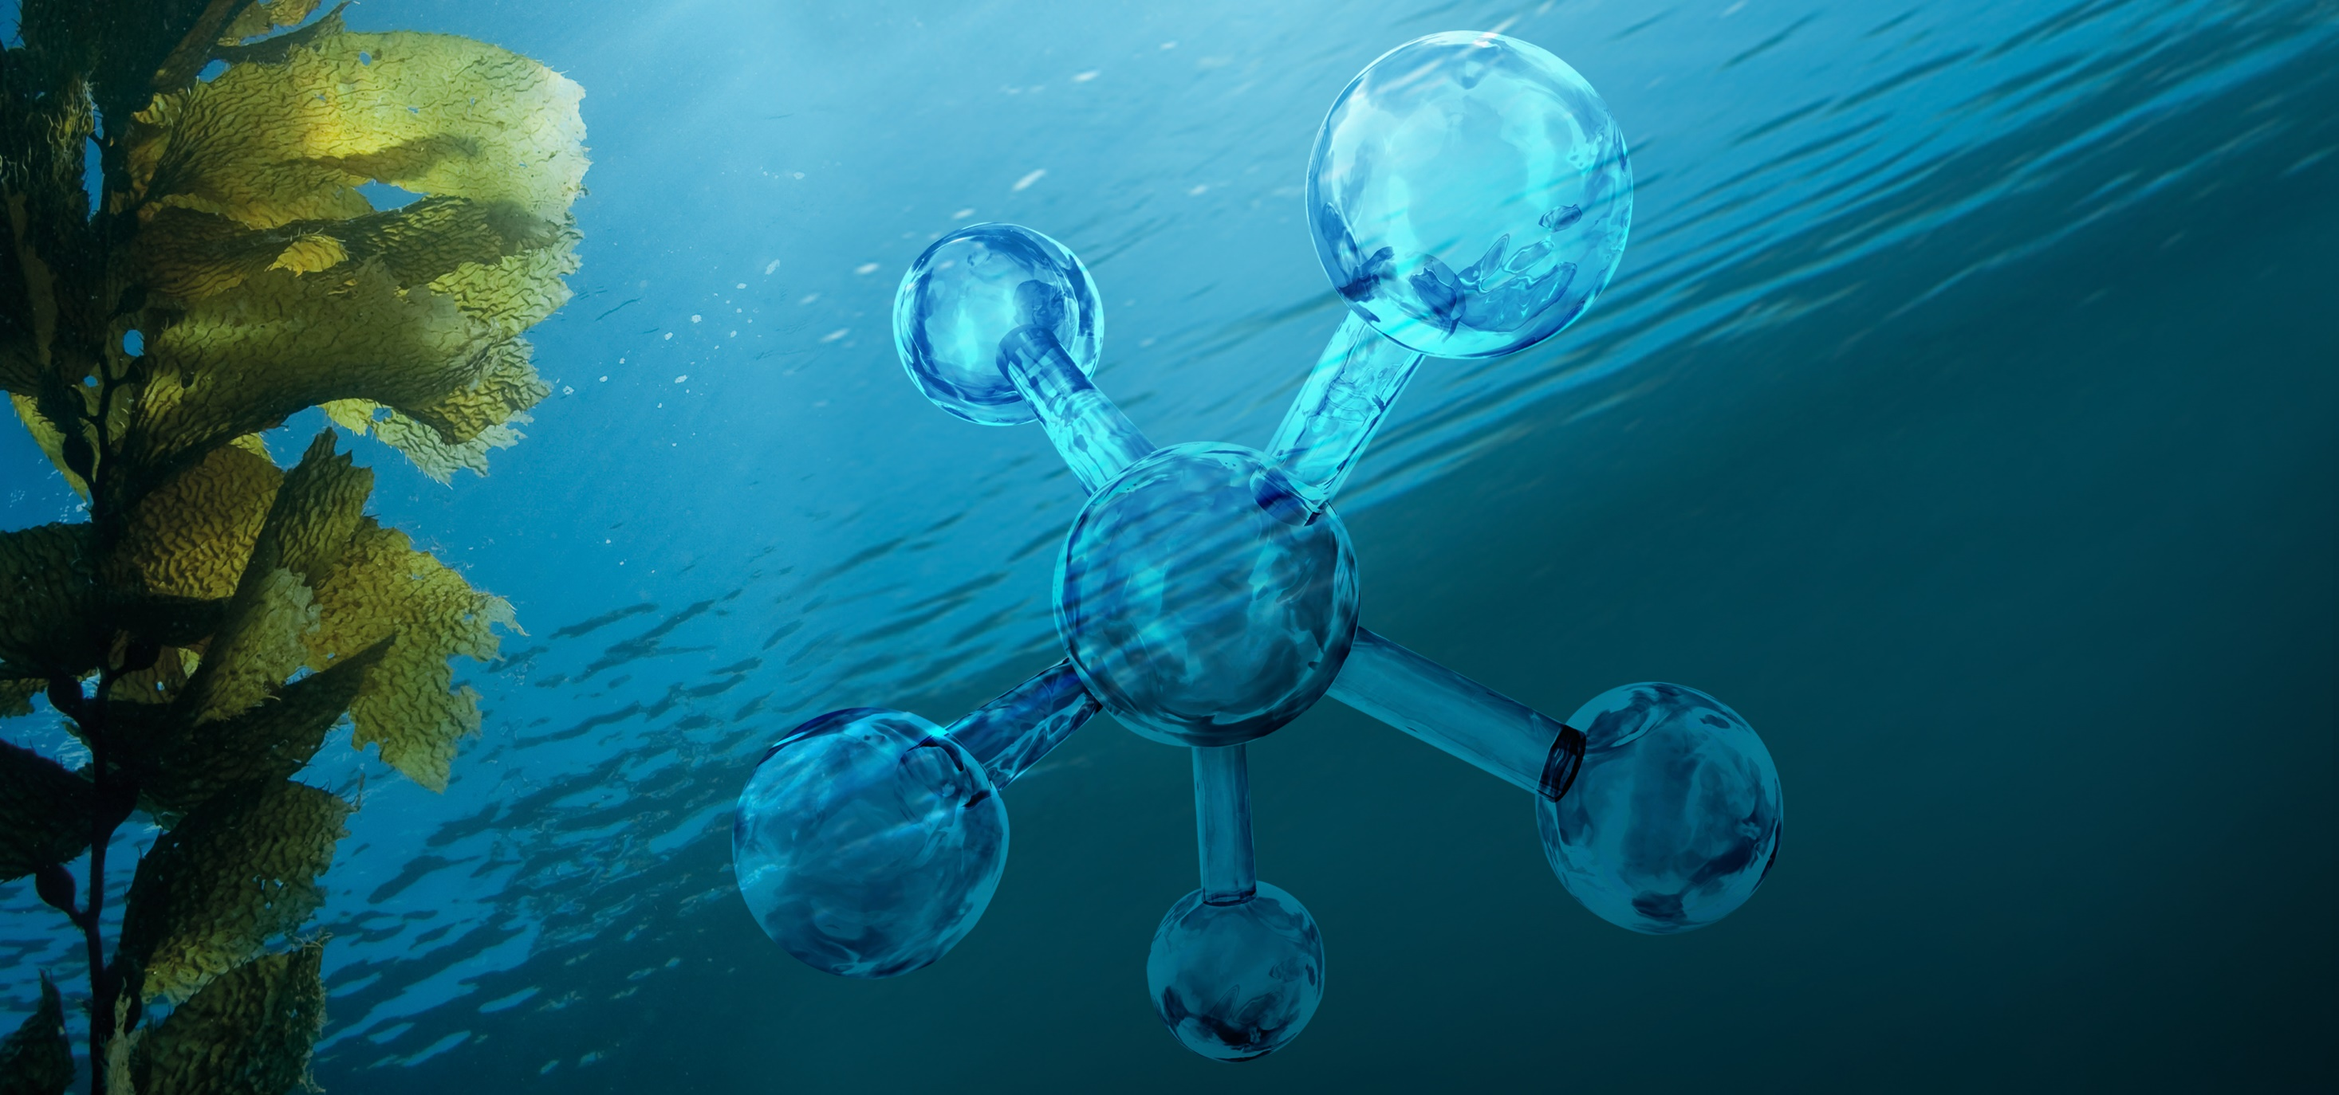
CELUMER MARINE EXTRACT
Shell
Algae
Seawater
Caviar
Plankton
Oyster

Slide 23
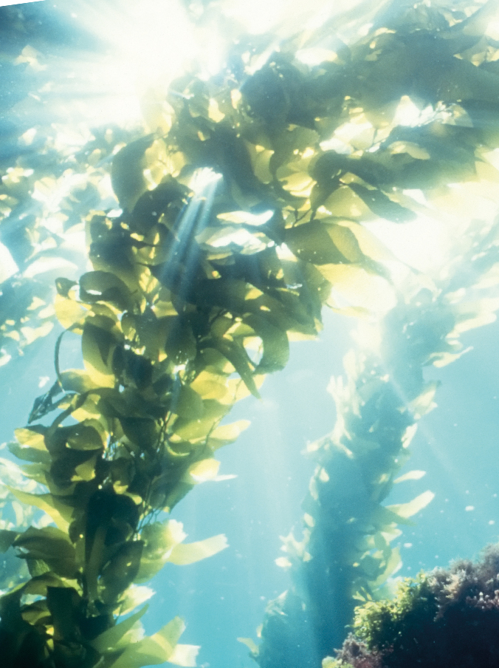
Algae
Algae are highly relevant in cosmetics. In order to grow and to proliferate, they need sunlight (photosynthesis) and nutrients, which they take from the environment they live in. That is why algae hold the entire richness of marine active agents. Additionally, algae are able to withstand the currents of the sea and to survive with very little light. The Celumer Marine Extract uses the active ingredients of the brown- and blue algae. Algae are true multi-talents, when it comes to skin care:
Possess strong antioxidative properties for excellent cell protection
They protect the elastic fibers to keep the skin firm and youthful
Rich in nutrients like iron, beta carotine and unsaturated fatty acids
Intensively moisturizing and very well tolerated by the skin
The alga is one of the six interactive ingredients in our exclusive Celumer Marine Extract.

Slide 24
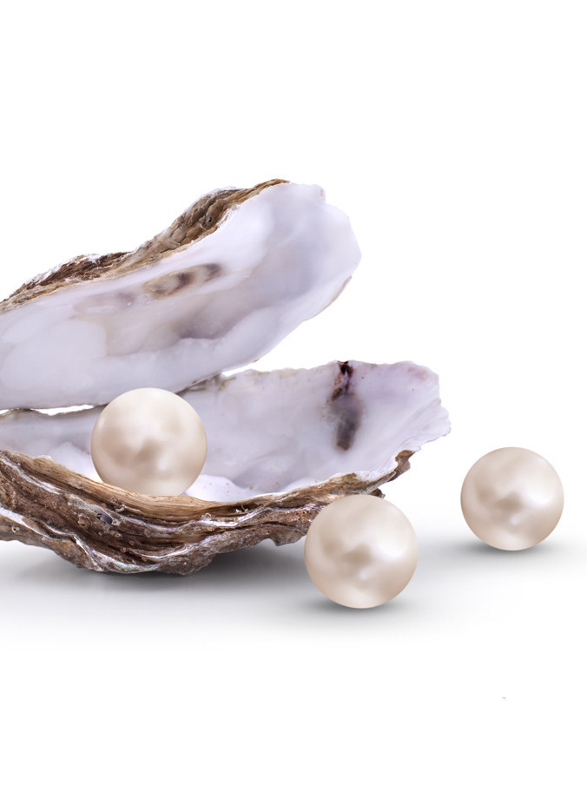
Oyster
Oysters (Ostreidae) have been around for over 250 million years, now as then celebrated as a culinary delicacy. Oysters contain a high amount of vitamins and minerals and offer high bioavailability with low caloric value. Oyster shell is often used in medical and cosmetic products, as it truly is a treasure chest of valuable skin-enhancers:
Amino acids and vitamins (B1, B2, B3, B5, B12) strengthen and nourish the skin
Valuable marine minerals & trace elements (potassium, phosphorus, natrium, zinc, calcium, magnesium, iron)vitalize the skin
For an even, mattified complexion
For healthy cell protection and beautiful, smooth skin
The oyster is one of the six interactive ingredients in our exclusive Celumer Marine Extract.

Slide 25
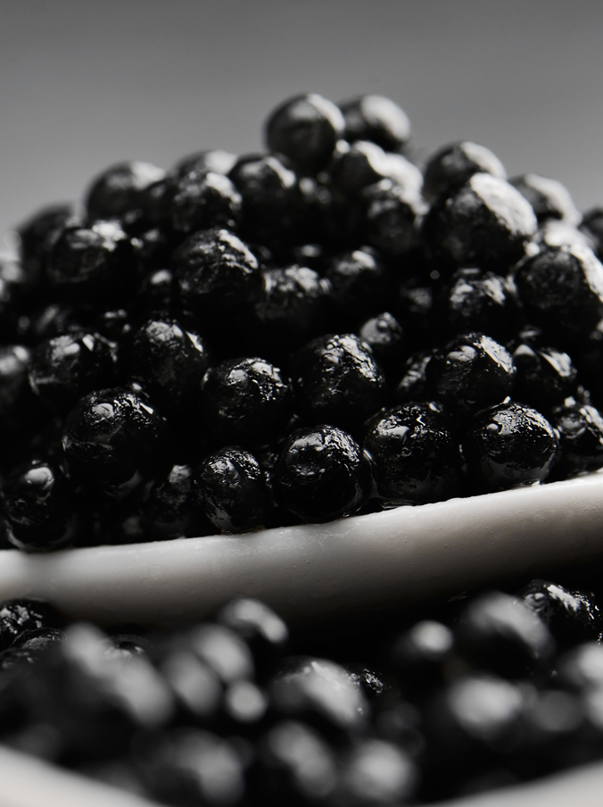
Caviar
Origin: Siberian sturgeon from sustainable, spezies-appropriate aquacultures in France.
In Germany, caviar is often called „the gold of the sea“. Over centuries, tsars, emperors and kings were ready to pay a lot of money for caviar and tried to get „exclusive rights“ to this delicacy. For its preservation, only pure salt is used.
Caviar has the following cosmetic benefits:
Contains a lot of proteins and unsaturated fatty acids
Moisturizing and nourishing for optimal skin protection
Protects the cell walls and enhances the bonding of skin cells with each other
Caviar is one of the six interactive ingredients in our exclusive Celumer Marine Extract.

Slide 26
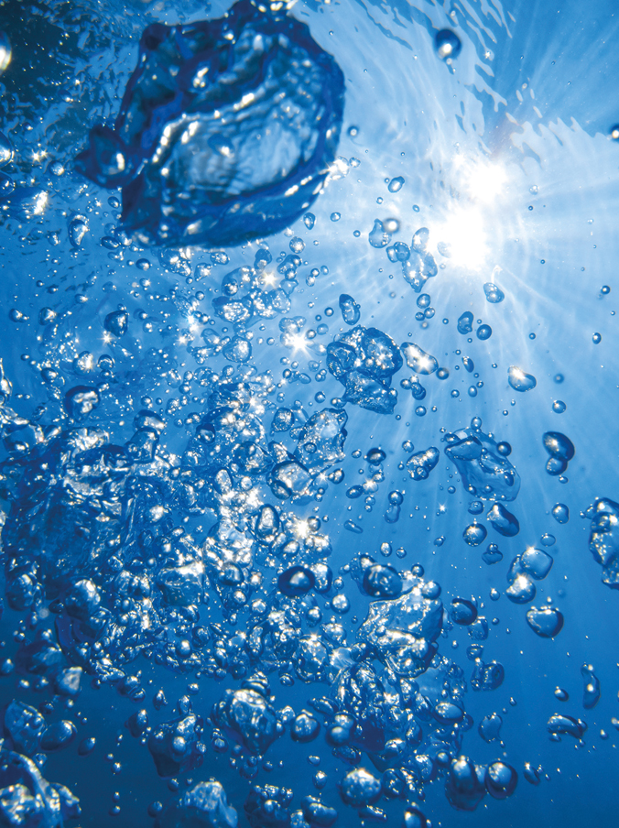
Seawater
Origin: Seawater from the French Atlantic coast. The seawater makes its way through granite formations and sandy layers and is won 22 meters below the surface.
The composition of its minerals and trace elements is amazingly similar to our blood plasma and lymphatic fluids, which makes it very relevant in cosmetics:
Moisturizing
Revitalizing
Strengthens cell communication by increasing lipid synthesis
Makes it easier and quicker to absorb active ingredients
Seawater is one of the six interactive ingredients in our exclusive Celumer Marine Extract.

Slide 27
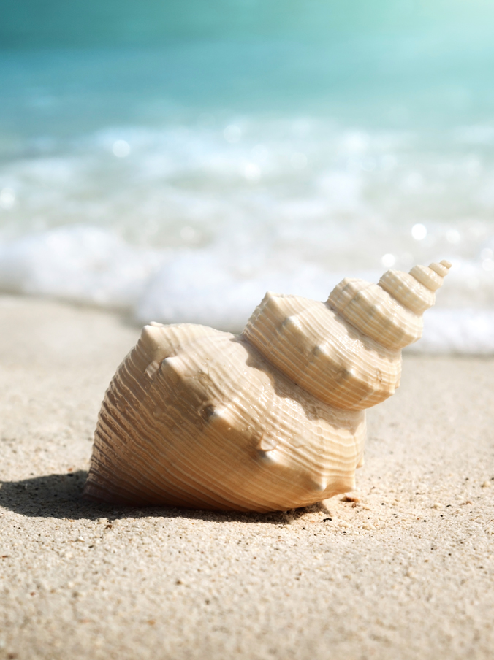
Shell
Origin: Shell sediment from the French Atlantic coast. Sustainably won at a depth of 30 meters.
They live at the bottom of the sea. Some are grown to riffs or the ground, some are floating above the sea bottom. Mussels are masters in the art of surviving - some live as long as 100 years. They obtain their food from the seawater, which gives them a whole variety of nutrients.
Cosmetic benefits of shells:
They are rich in calcium carbonate
They have a detoxifying effect
Strengthen the connective tissue
Remineralise, regenerate and nurture
The shell is one of the six interactive ingredients of our exclusive Celumer Marine Extract.

Slide 28
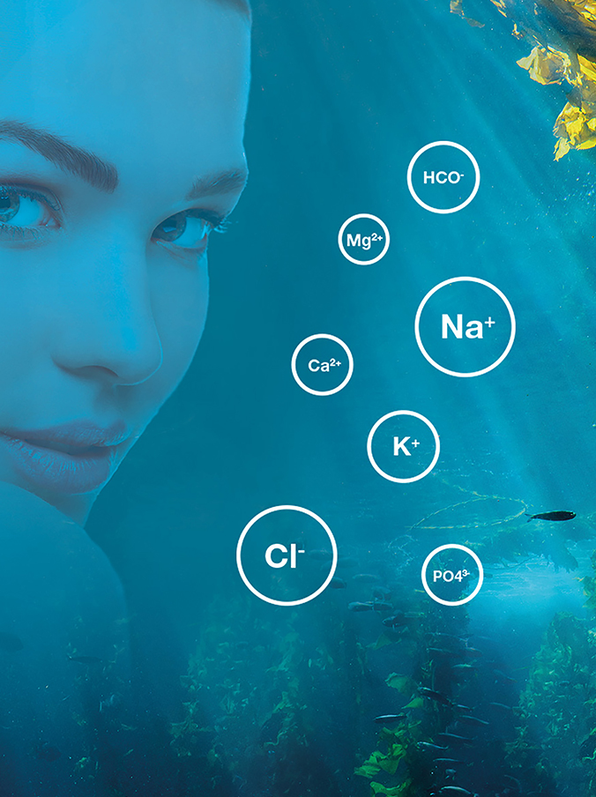
Celumer Marine Minerals
The composition of the Celumer Marine Minerals is similar to blood plasma, which allows for quicker absorption of active ingredients into deeper layers of the skin. As the combination is known to the body, they serve as a „means of transport“ for further active ingredients into the skin.
Cell supply
Better absorption of active ingredients
Very well tolerated by the skin

Slide 29
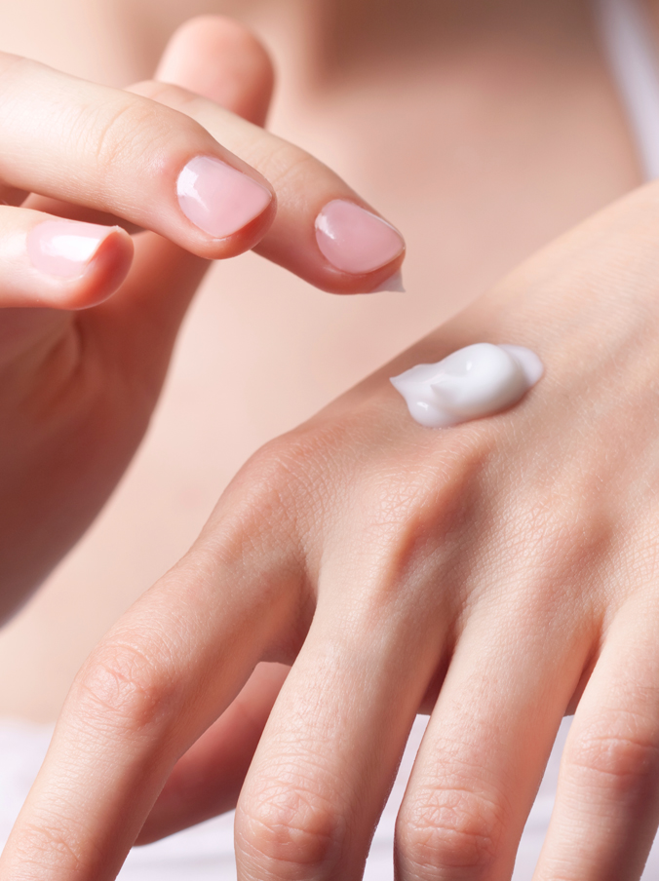
Panthenol (Provitamin B5)
Assists the skin in retaining moisture
Helps enhance skin elasticity
Offers anti-inflammatory and soothing properties
Promotes skin cell renewal (epithelialization)

Slide 30
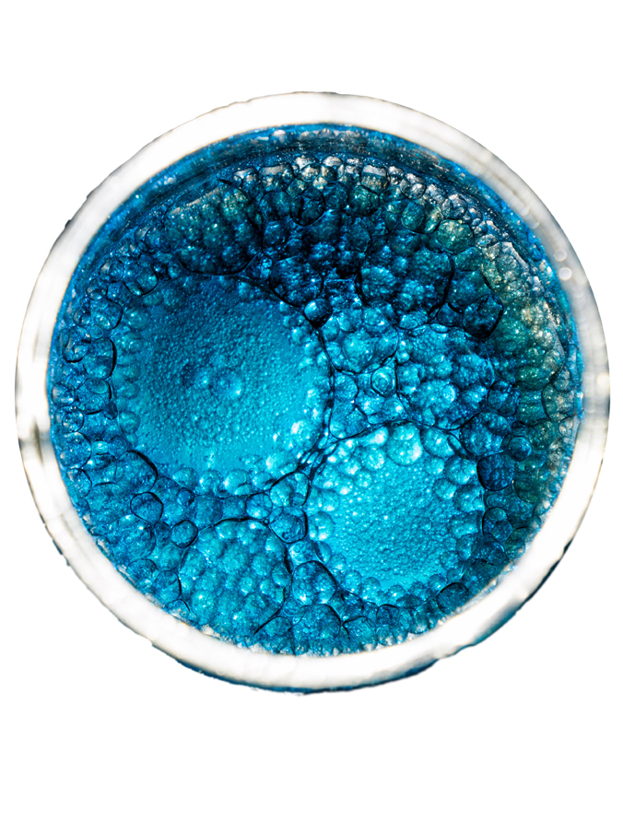
Plankton
Origin: Northwest France, won at an estuary, where fresh water and salt water meet and mix. That is why the ecosystem is especially healthy and characterised by variety.
Plankton are microscopic organisms that float in great numbers in the sea. They absorb carbon dioxide and sunlight to produce energy for healthy growth and metabolism. Excessive exposure of plankton to solar UV radiation results in the formation of an enyzme that is able to repair UV light induced cell damage. The essential nutrients contained in plankton are true all-rounders!
Accelerate the differentiation of skin cells for more freshness and youthfulness
Possess antibacterial properties, which strengthens the skin‘s protective barrier
Protect against UV-induced oxidation, thus discouraging premature skin aging
Plankton is one of the six interactive ingredients of our exclusive Celumer Marine Extract.

Slide 31
Q10
Q10 – a co-enzyme produced naturally in the body – is a necessary element for the regeneration of the skin. Once the aging process slows down the body’s own production of Q10, cell activity is reduced, nutrients are absorbed more slowly and the disposal of harmful substances to the tissue fluid is decelerated. All in all, the skin becomes more fragile towards harmful environmental influences and symptoms of aging become visible. Thanks to Q10, the natural biological energy process in the skin is reactivated.
Protects against oxidative stress
Protects against premature skin aging
Protects against UV damage
Supports cell activity
For more energy & freshness

Slide 32
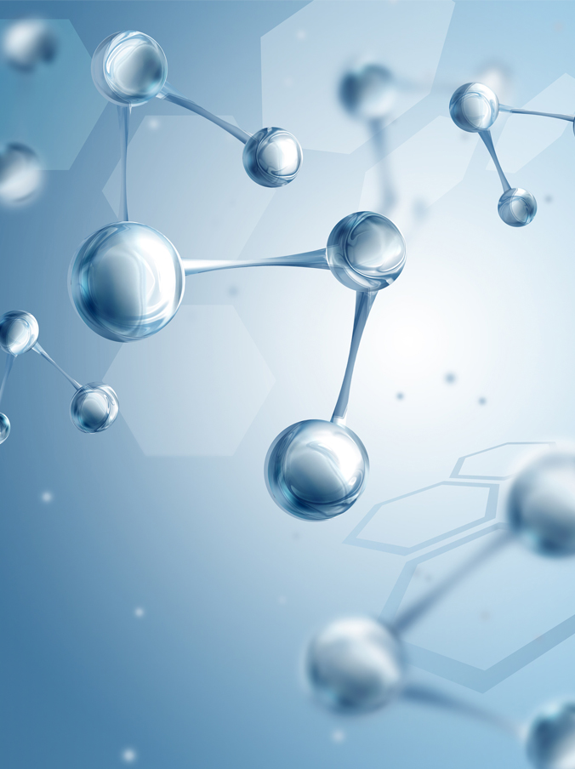
Hyaluronic Acid
is obtained through biotechnology. Hyaluronic acid is a component of the extracellular matrix of the skin. It is a glycosaminoglycan which is a physiologically relevant component of connective tissue and plays a role in cell proliferation & cell migration.
Hyaluronic acid offers these impressive beauty benefits:
delivers intense moisturization
has an outstandingly high moisture retaining capacity
it is well tolerated by the skin (important component of the NMF)

Slide 33
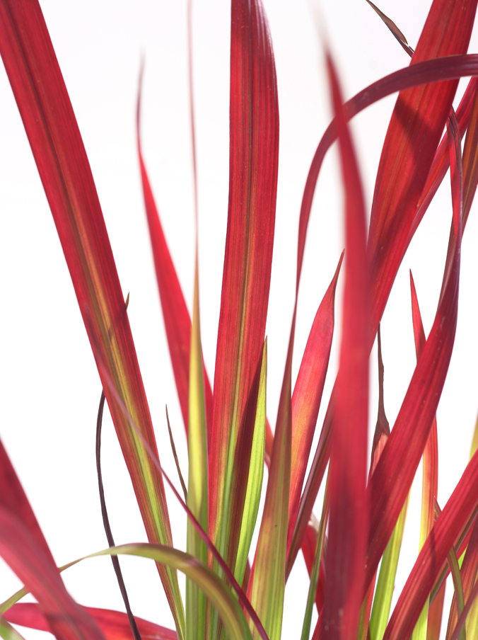
Japanese Blood Grass
Japanese Blood Grass (lat. Imperata Cylindrica) is native to Asia where it is used as a medical plant, amongst other things.
Provides intense and long-lasting moisture
For a fresh and healthy complexion

Slide 34
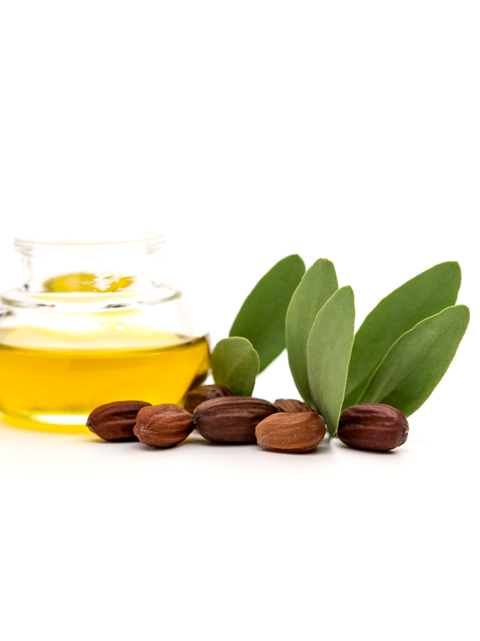
Jojoba Oil
A precious liquid wax obtained from the seeds of the Jojoba shrub (Simmondsia chinensis) which offers these benefits:
Penetrates quickly into the skin without leaving it oily
Provides skin softness and suppleness
Is well tolerated by the skin
Counteracts premature skin aging
Is perfect for rough, dry and sensitive skin

Slide 35
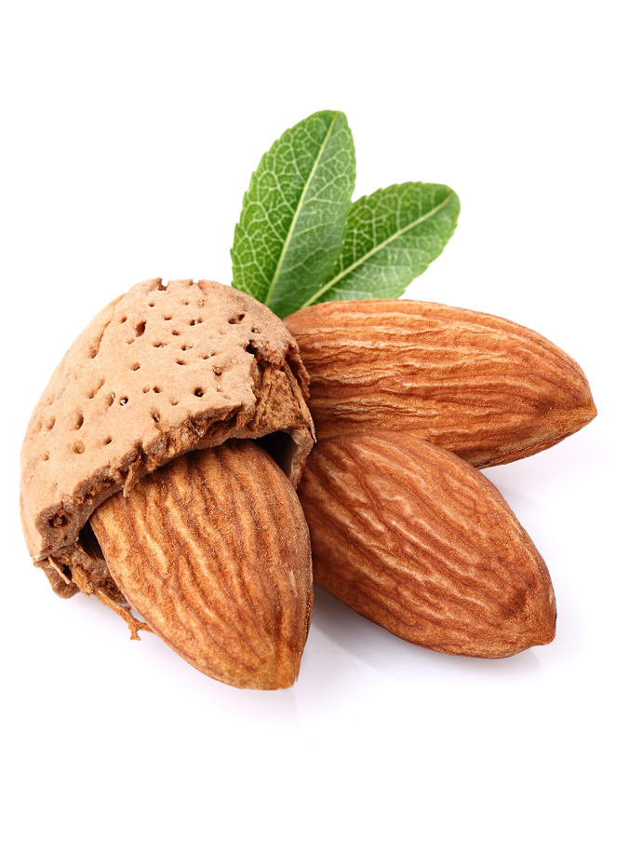
Almond Oil
The oil is well tolerated by the skin and therefore also suitable for use on problem skin
Delivers moisture and vitamins to the skin and, at the same time, protects skin against moisture loss
Helps make skin more resilient, thus reducing the appearance of fine lines and wrinkles

Slide 36
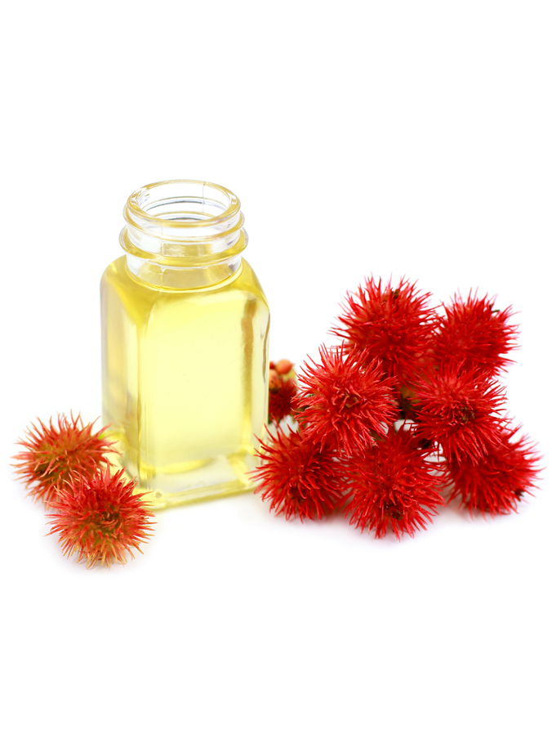
Castor Oil
Castor oil is obtained from the seeds of the castor oil plant(Ricinus communis). In ancient times, castor oil was commonly used as a medical remedy. Today, it offers these properties in skin care:
Protects against harmful environmental influences
Stimulates collagen synthesis
Improves skin firmness and reduces wrinkles
Ideal for the treatment of scarred tissue, keeping it soft and more supple

Slide 37
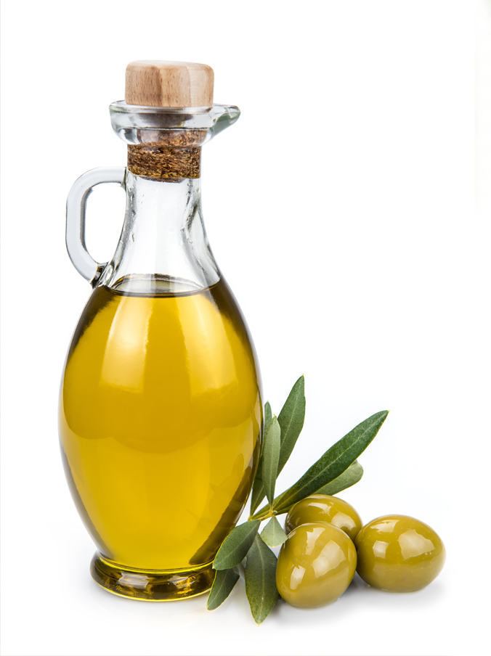
Squalane
Is mostly won from plant oils (e.g. olive oil). It is very similar to the skin‘s own „squalene“, a part of sebum, and thus ensures maximum skin tolerance.
Provides moisture
Antioxidant
Makes the skin soft and supple

Slide 38
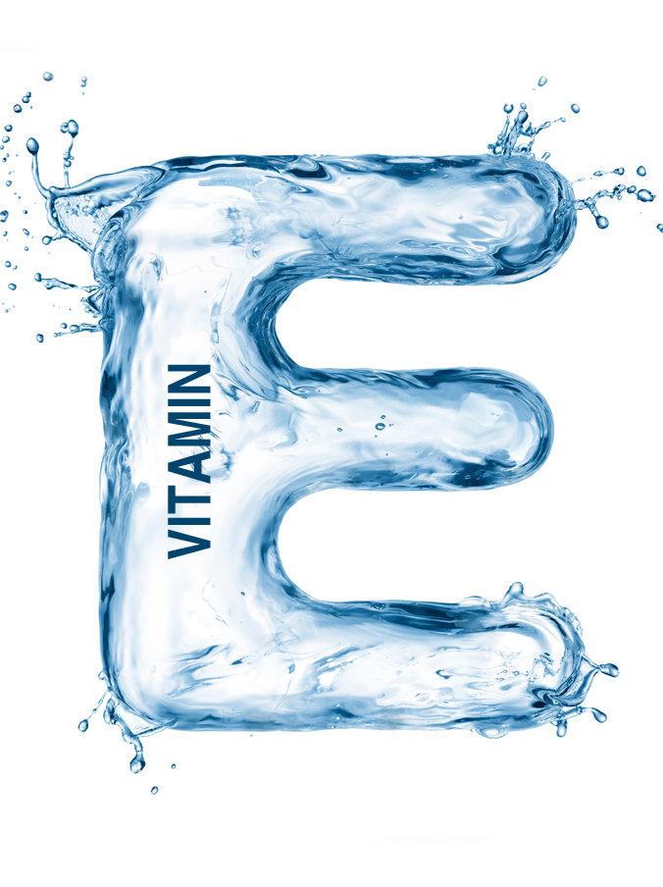
Vitamin E
Vitamin E is not just a single substance, but a whole family of fat-soluble nutrients. However, the term vitamin E is generally used for α-tocopherol, the best-researched form of vitamin E. The body obtains vitamin E through dietary intake. The richest sources of vitamin E are vegetable oils. Vitamin E was first discovered as a ‘fertility vitamin’ by US researchers Herbert M. Evans and Katherine S. Bishop in 1922. In the following years, the vitamin was isolated from wheat germ oil, corn and oats. Since vitamins A, B, C and D were already discovered, tocopherol was given the name vitamin E.
Anti-aging vitamin
Strong antioxidant effect -> protects the cells
Improves the epithelialization of the skin and its ability to retain moisture

Slide 39
COPYRIGHT & DISCLAIMER
COPYRIGHT. All pictures and images, the presentation design and the content provided in this training material are subject to copyright law and intellectual property protection and may only be used for the training of authorized DALTON aestheticians. Any distribution (analog/digital) or the use of any text or image requires the prior written consent of DALTON COSMETICS GERMANY GmbH.
DISCLAIMER. This training material forms part of the theoretical and practical training concept of DALTON COSMETICS GERMANY GmbH and requires further verbal explanation and practical experience to be complete. Therefore, DALTON COSMETICS GERMANY GmbH cannot be held liable for the completeness of the information provided herein.
DALTON COSMETICS GERMANY GmbH
Schulungsabteilung / Training Centre
Hauptstr.6, 94571 Schaufling, Deutschland / Germany

